Slide 1
NOISE

Slide 2
NOISE
Have we ever seen it closely?

Slide 3
NOISE
Or we have only seen it too closely!

Slide 4
Imagine

Slide 5
Imagine
Scenario where you wish to take a photo, a life-time shot, an extremely rare occurrence.
But you somehow, the lighting is too less or the camera exposure itself is too low.
What NOW?
There is no way we can replicate the shot.
All we can do is digitally process the image.

Slide 6
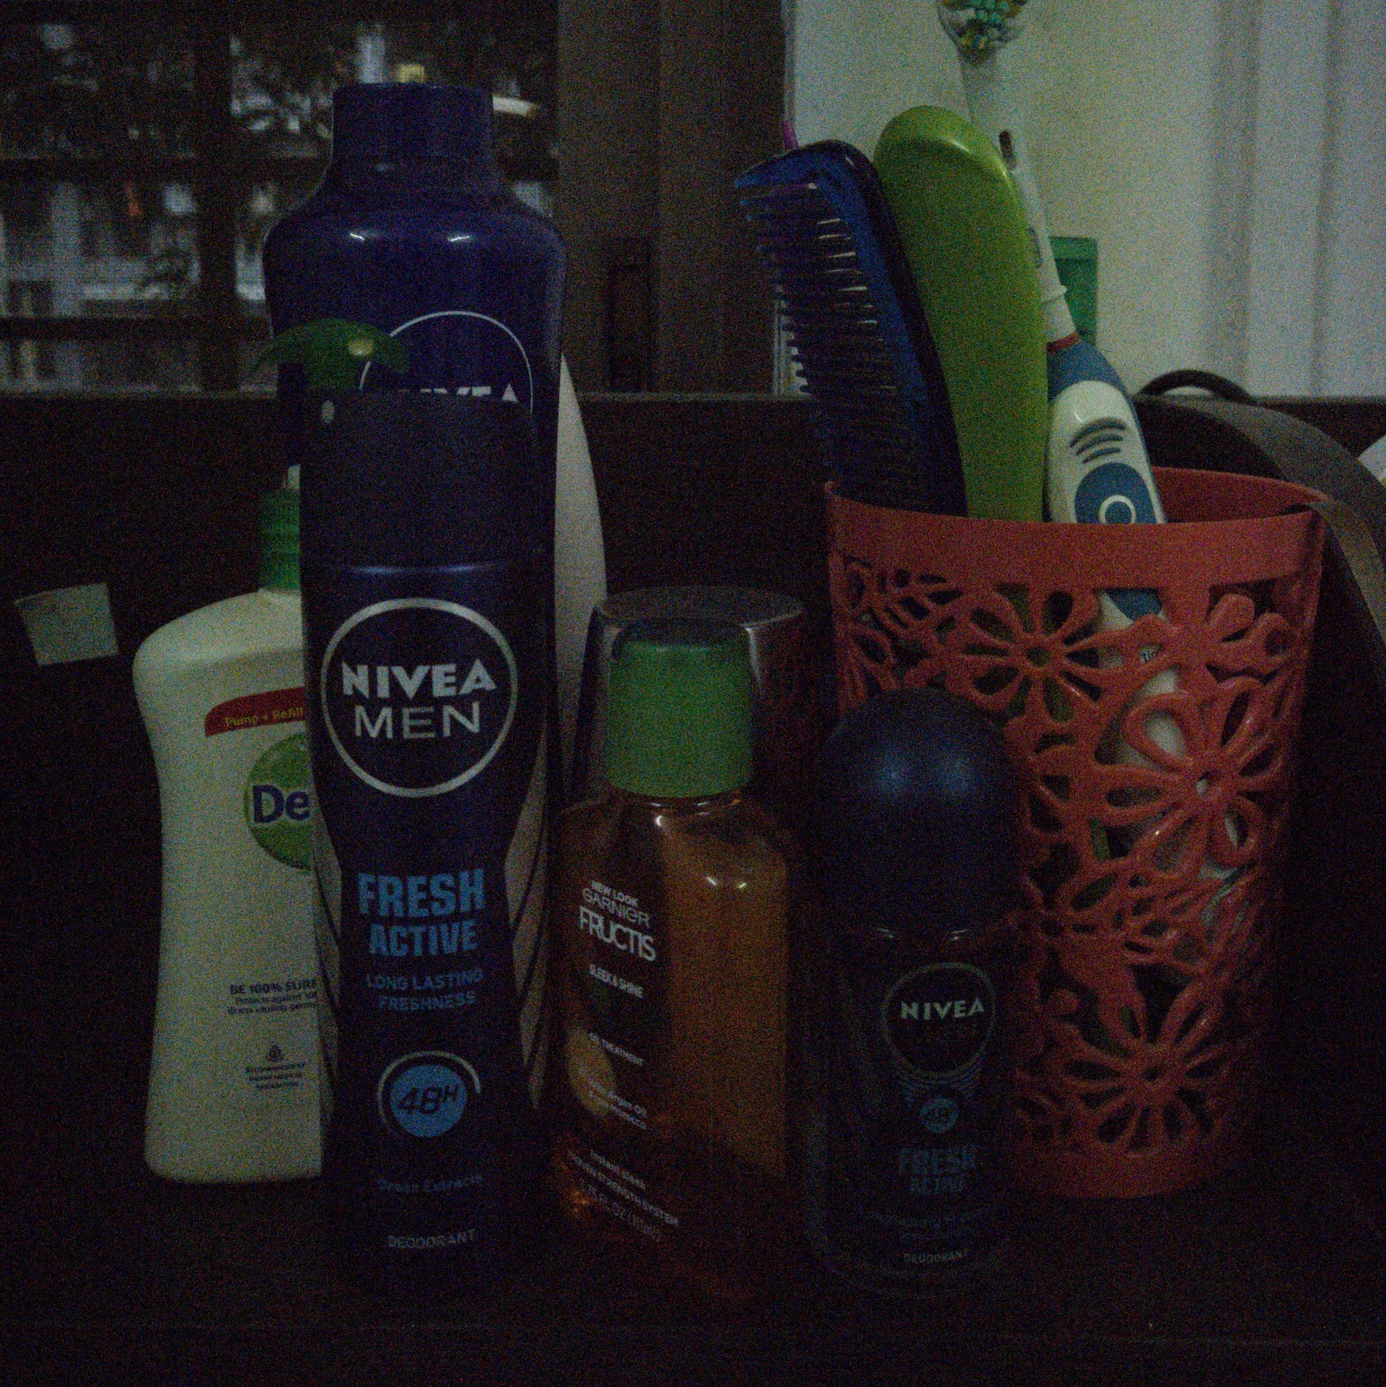
Example

Slide 7
Which boat to sail?

Slide 8
Sail the old boat?
We can definitely the conventional methods like
Gaussian Filtering
Bilateral Filtering
Reconstruction using Eigen Vectors
PCA Based Denoising
etc.

Slide 9
Sail the old boat? Or a trendy one?
But we all know that their performances are limited.
By the way, we have heard that Neural Networks are great at doing this job!
That’s great news!
Let’s train a Neural Network!
Yes! Yes!! It’s a solved problem!!!
Done and Dusted!

Slide 10

Sail the old boat? Or a trendy one?
We’ve learned that we can train a Neural Network with
$$(x_{i}, y_{i})$$
pairs where $x_{i}$ is the noisy input and $y_{i}$ is the clean output.
That is, we need lots and lots of noisy images for inputs and equally mapped clean images for output.
So we’ll as the model (for training) to do the following:

Slide 11
Sail the old boat? Or a trendy one?
Less Noisy Image
Clean Image
More Noisy Image
Very Noisy Image
Neighbourhood

Slide 12
The Big BUT!
But what if we don’t have the clean image?
There is just no means to get a clean image?
How are we going to train the model then?
Can we use the Noise itself to train it?
Seriously?

Slide 13
The WISDOM of the CROWD

Slide 14
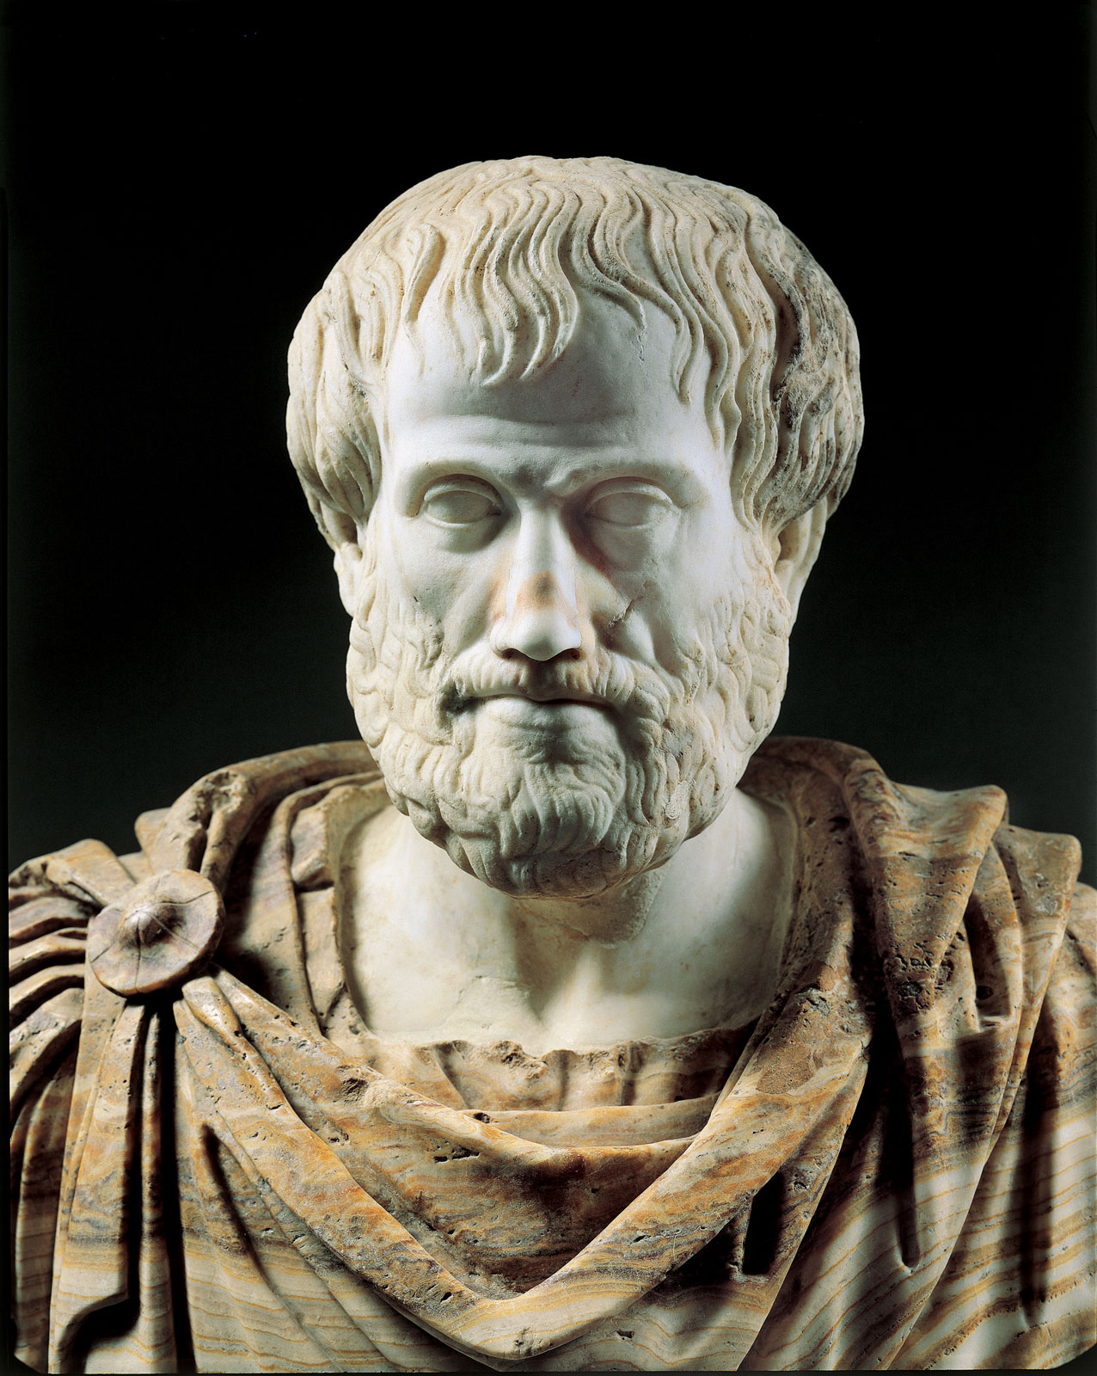
The WISDOM of the CROWD!
Before we can challenge the problem at hand, let’s go back in time to Aristotle and for some insights and knowledge.

Slide 15
The WISDOM of the CROWD!
He said, “it is possible that the many, though not individually good men, yet when they come together may be better, not individually but collectively, than those who are so, just as public dinners to which many contribute are better than those supplied at one man's cost”.

Slide 16
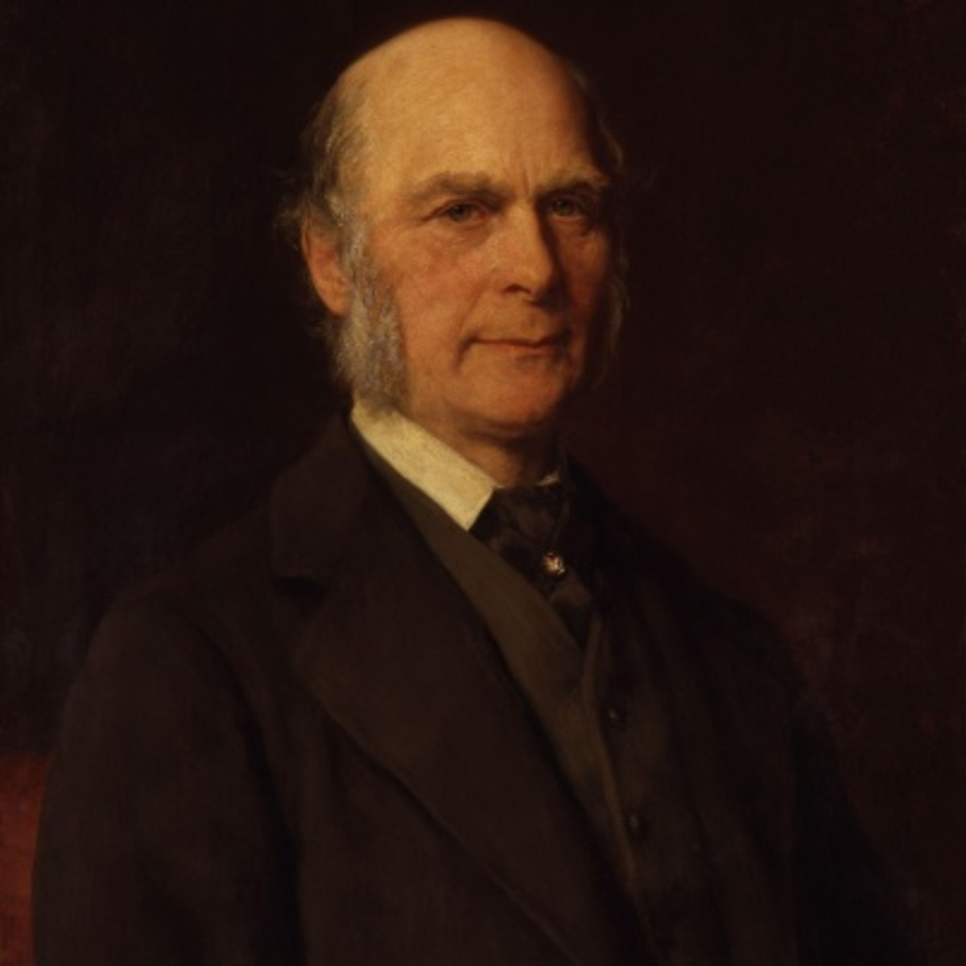
The WISDOM of the CROWD!
In 1907, Sir Francis Galton asked 787 villagers to guess the weight of an ox.
The person to guess correctly would win that ox.
People’s guess were all over the place.
But surprisingly, the mean was too close to the actual weight!

Slide 17
The UNIQUE boat
Similarly, we can use the Nosie to estimate the true mean.
That is, in expectation, the noise patterns would converge to the actual mean!
And what if it’s a ZERO MEAN NOISE?
We calculate its expectation which to zero.
Hence, we have eradicated the noise!

Slide 18

The UNIQUE boat: Noise2Noise
Noisy Image
Clean Image
$$E[ ]$$
Neighbourhood

Slide 19

The UNIQUE boat: Noise2Noise
We make the model predict noisy images which are drawn from the same model of input noisy image
When we train it many instances, it converges to the ground truth pixel value.
But, here, selection of Loss Function is crucial
For example, if we want the noise to converge to mean, we choose $L2$ Loss Function, but if we want to converge it to median, we choose $L1$ Loss Function.

Slide 20
Noise2Noise

Slide 21
Noise2Noise
UNET Architecture
5 encoding blocks
5 decoding blocks
Loss function dependent on noise type.
Dataset
BSD500

Slide 22
Results

Slide 23
Gaussian Noise

Slide 24

Gaussian Noise
$μ = 0$
$σ = 0.1$
Loss Function: $L2$

Slide 25
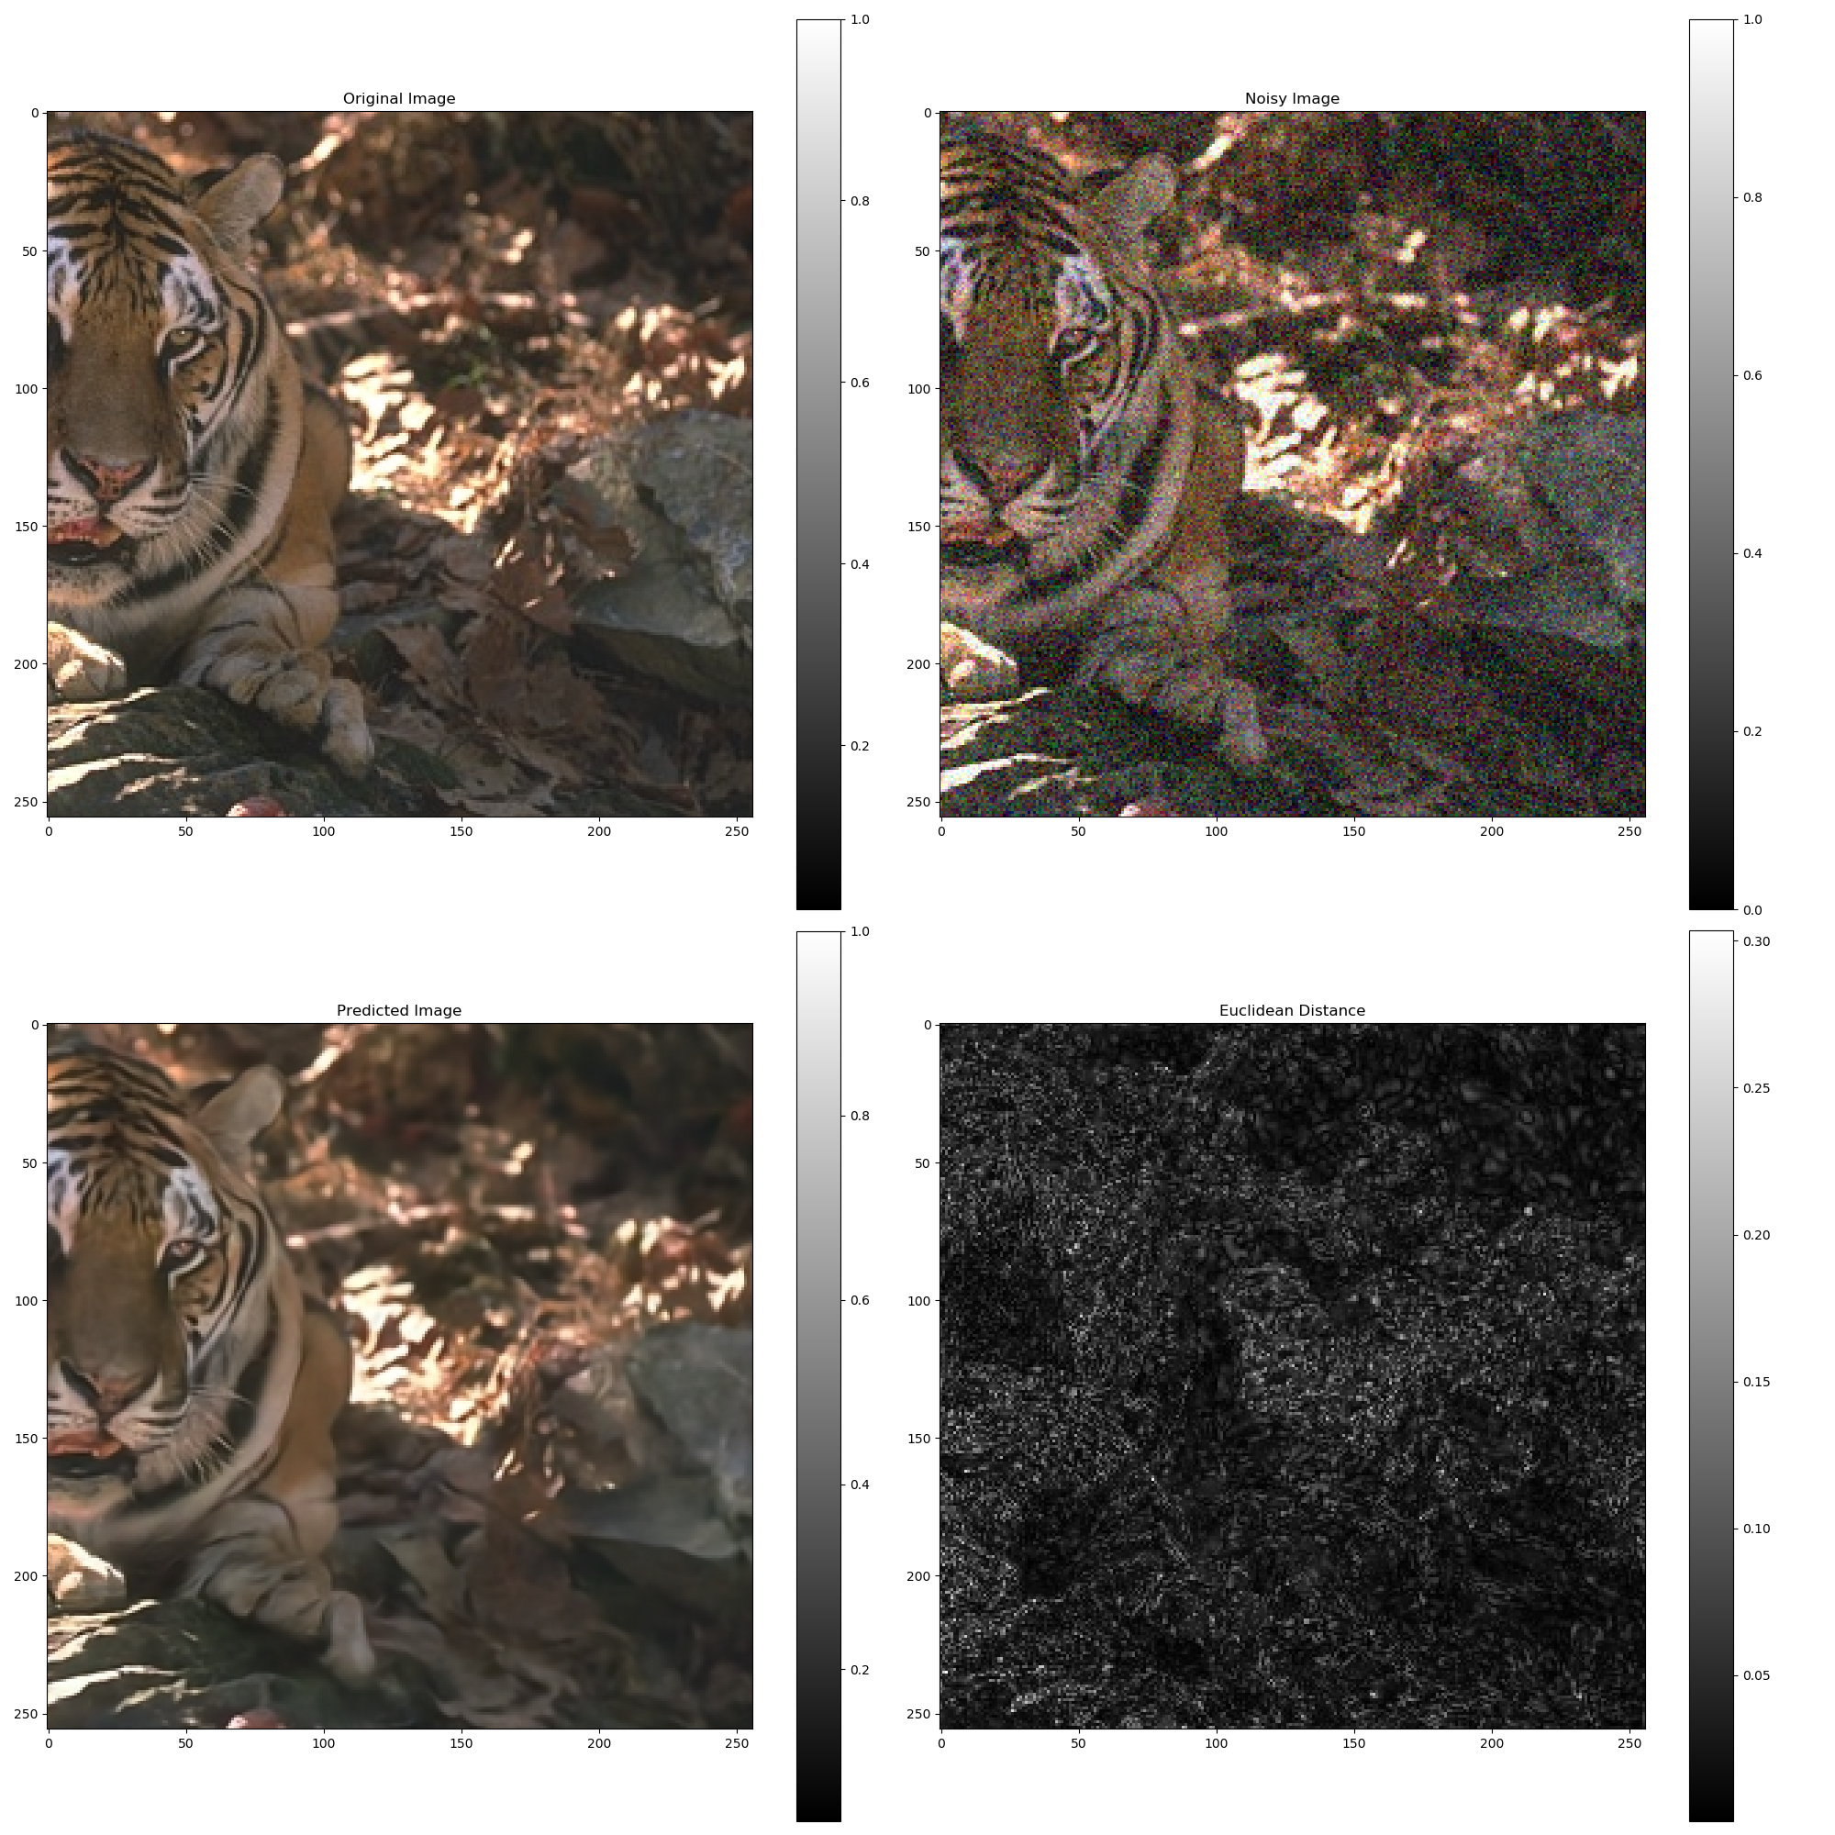
Gaussian Noise

Slide 26
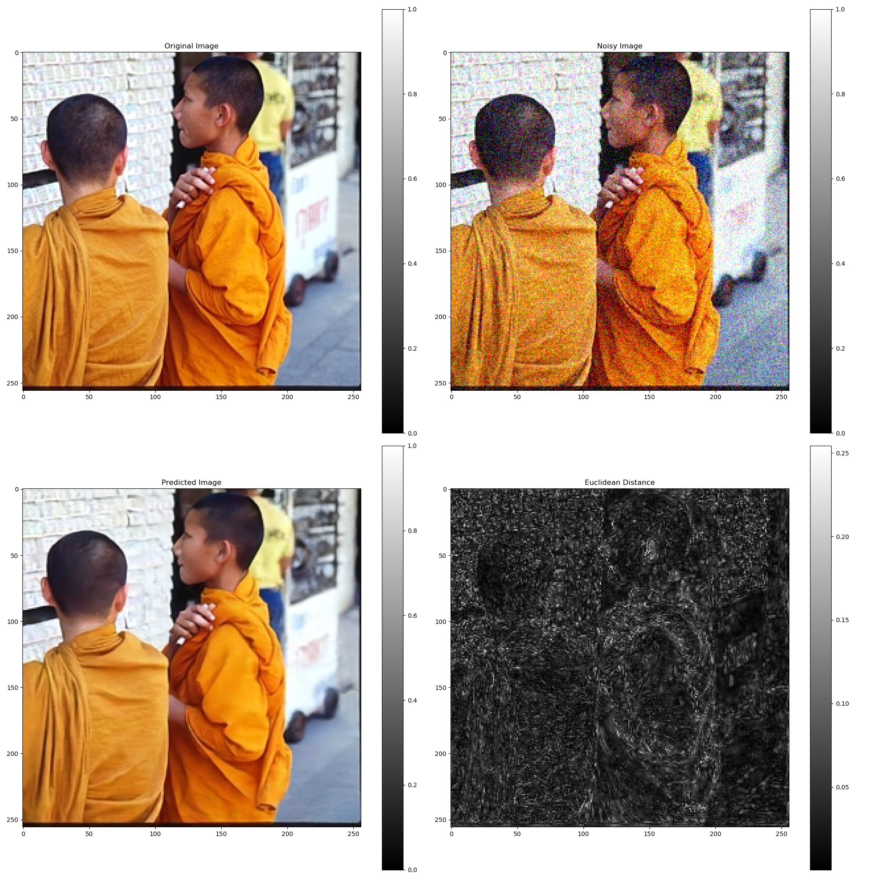
Gaussian Noise

Slide 27
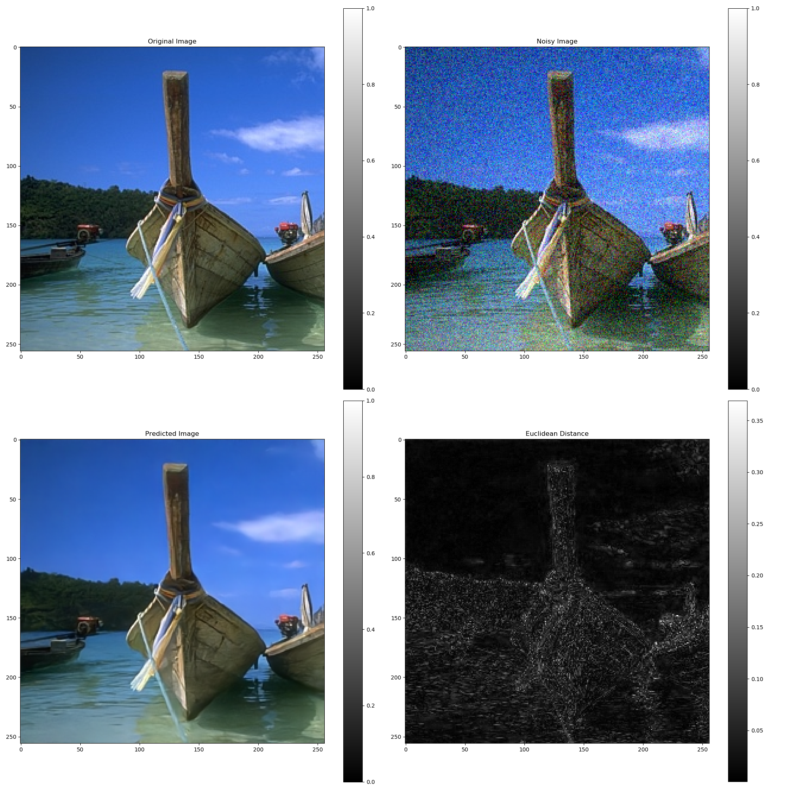
Gaussian Noise

Slide 28
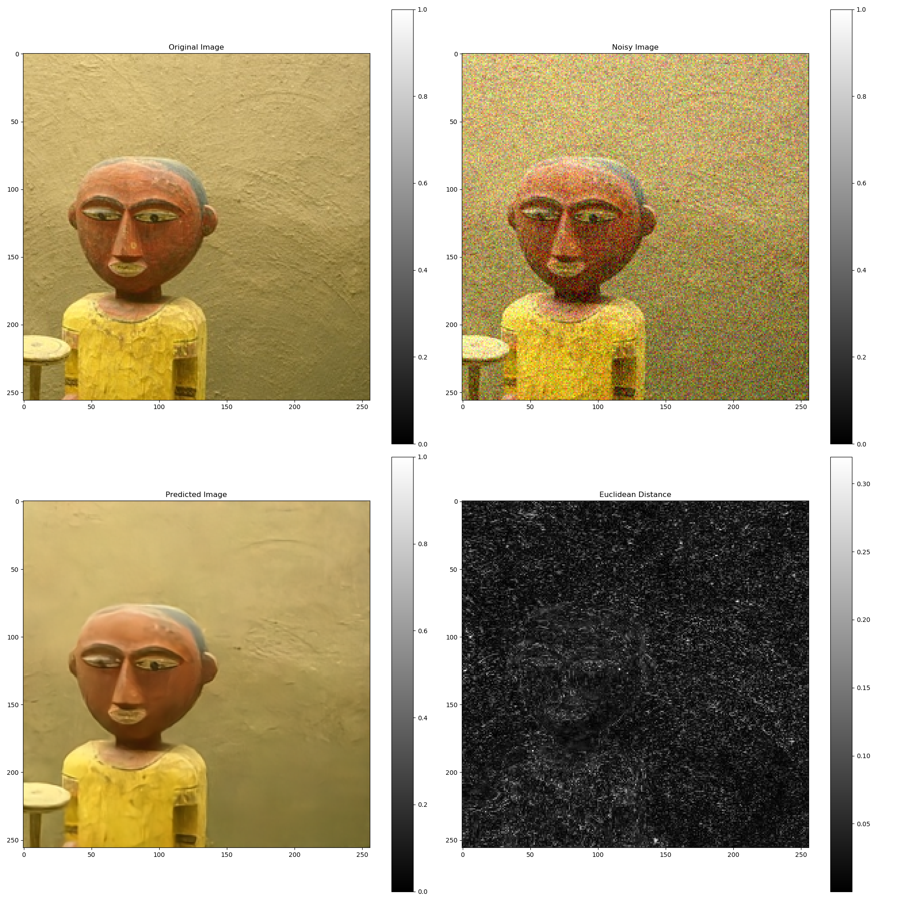
Gaussian Noise

Slide 29
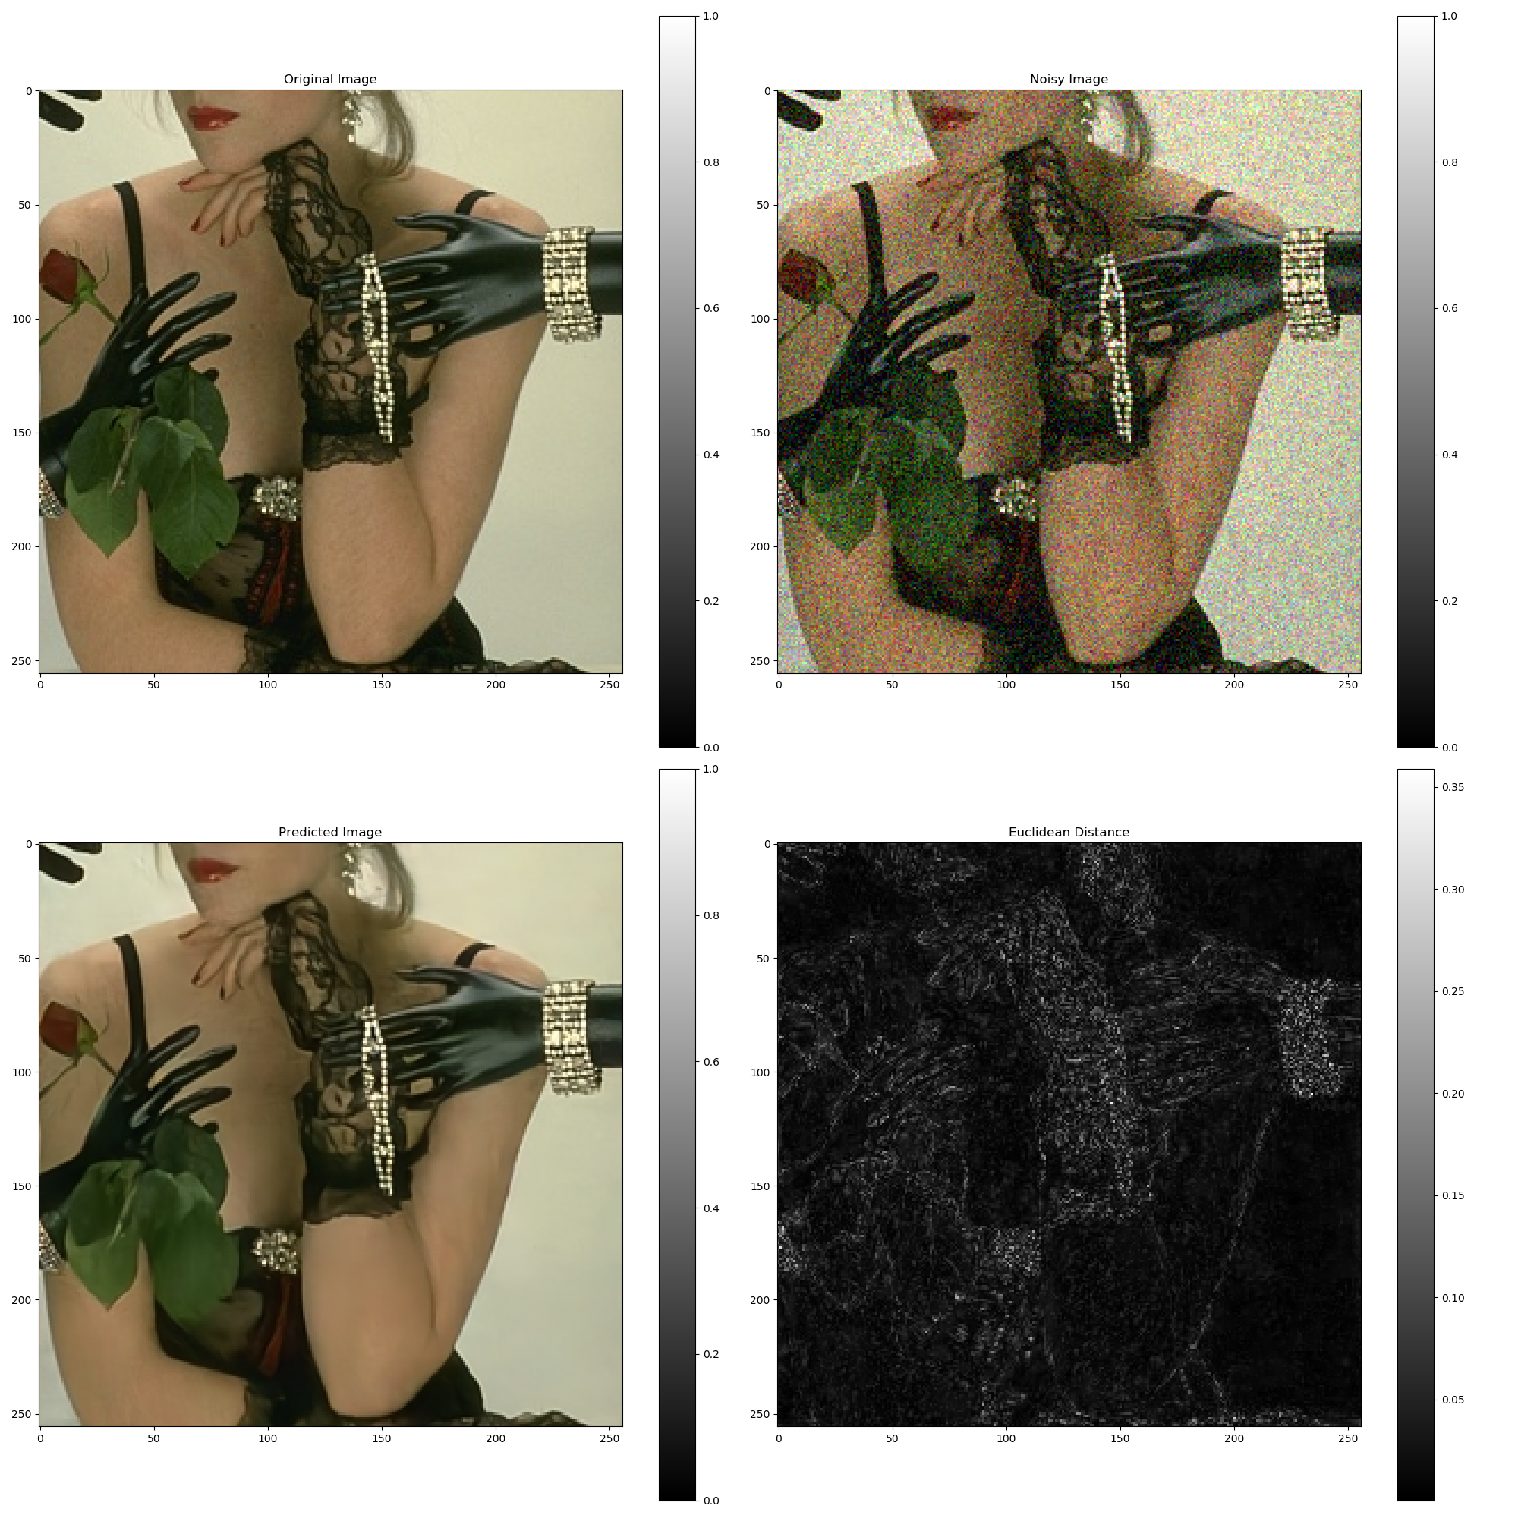
Gaussian Noise

Slide 30

Gaussian Noise
Putting it to Test
$μ = 0$.2
$σ = 0.1$
Loss Function: $L2$
Expectations?
A Brighter Image?

Slide 31
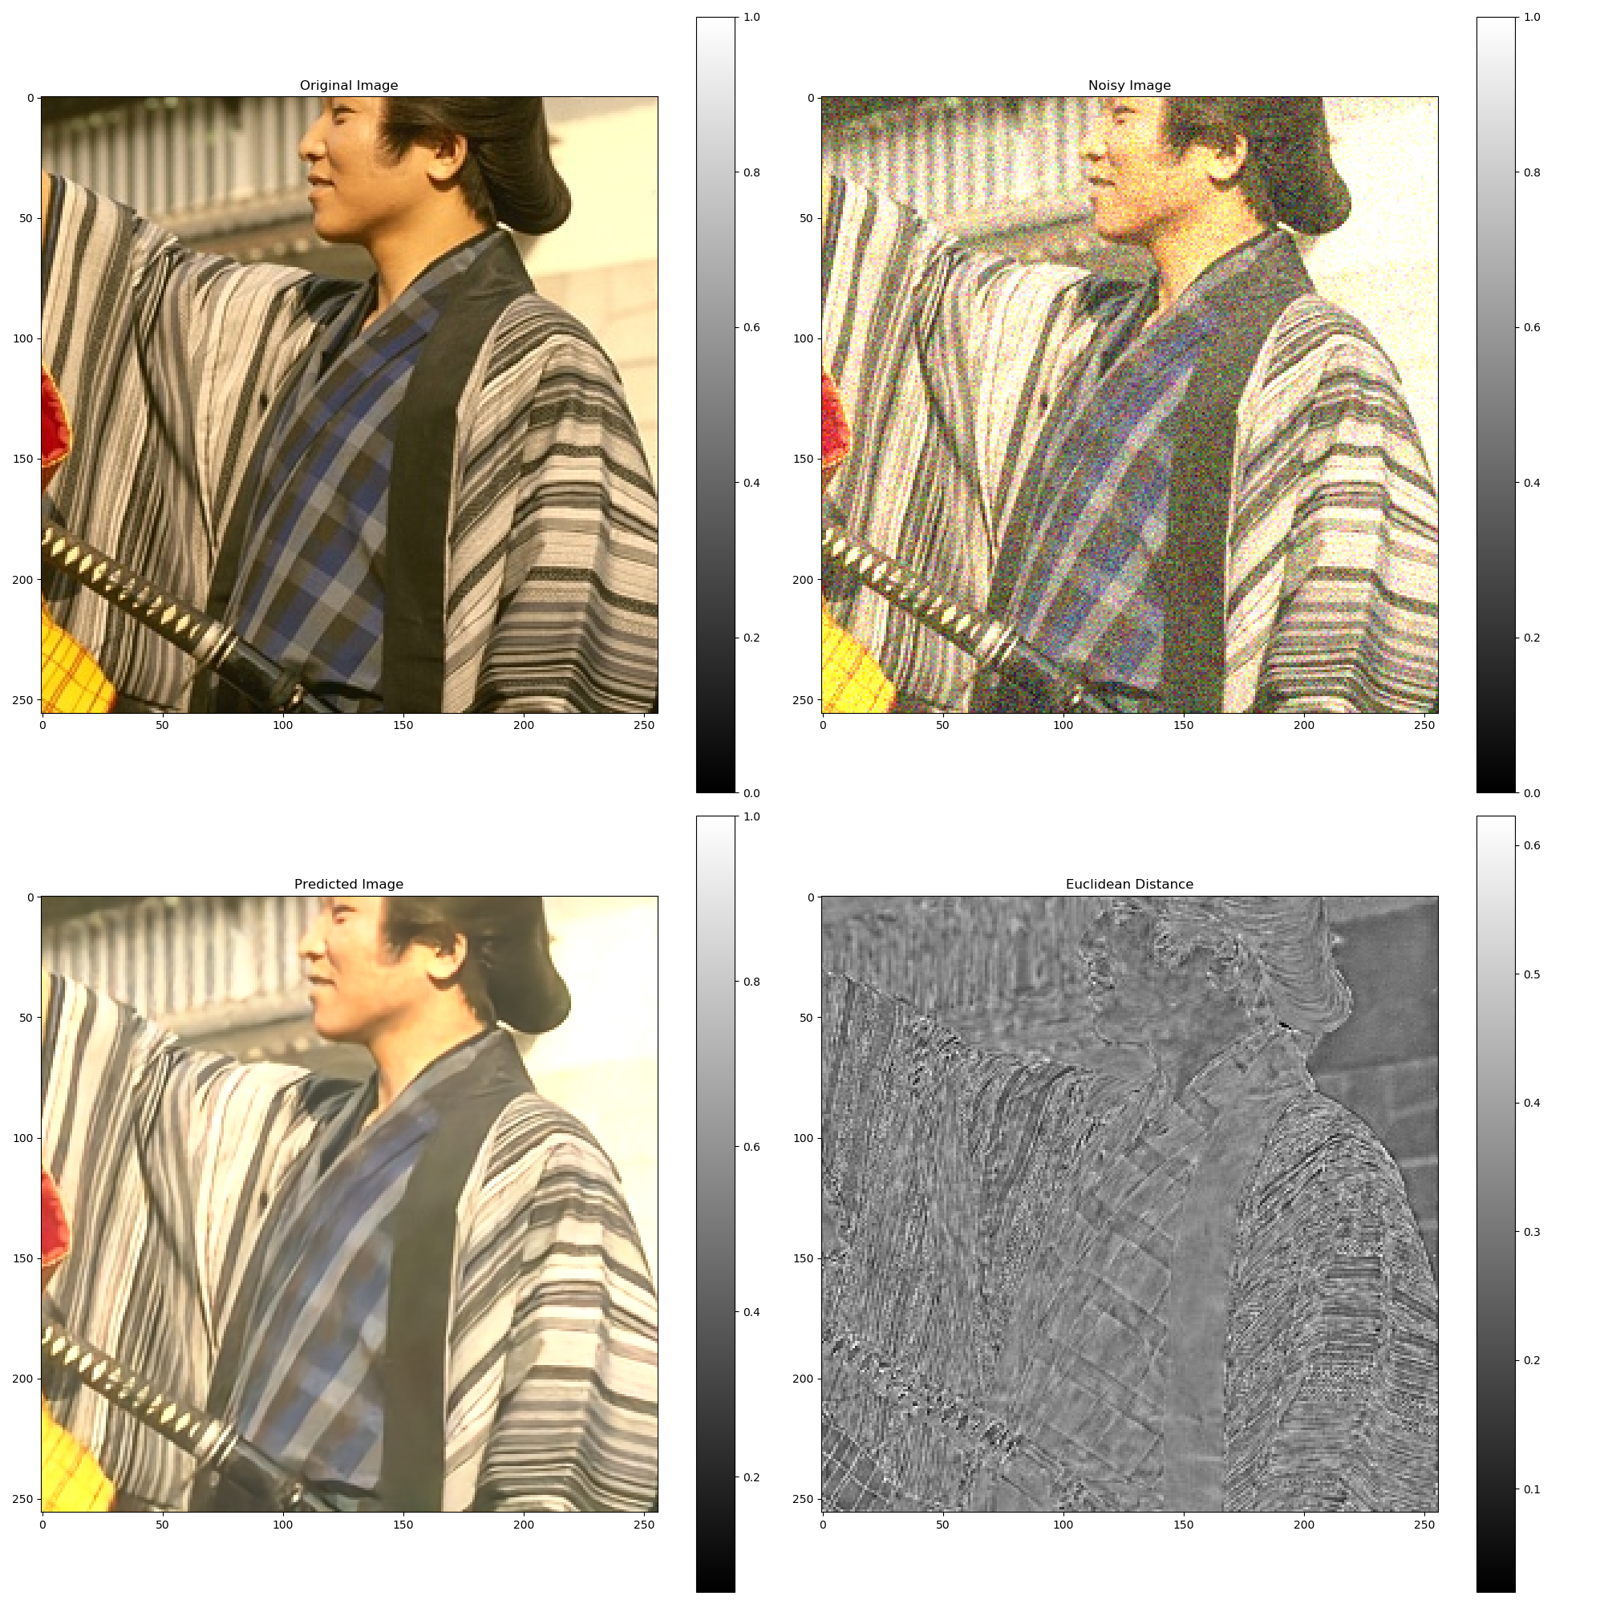
Gaussian Noise

Slide 32

Gaussian Noise
Putting it to Test
$μ =−0.2$
$σ = 0.1$
Loss Function: $L2$
Expectations?
A Darker Image?

Slide 33
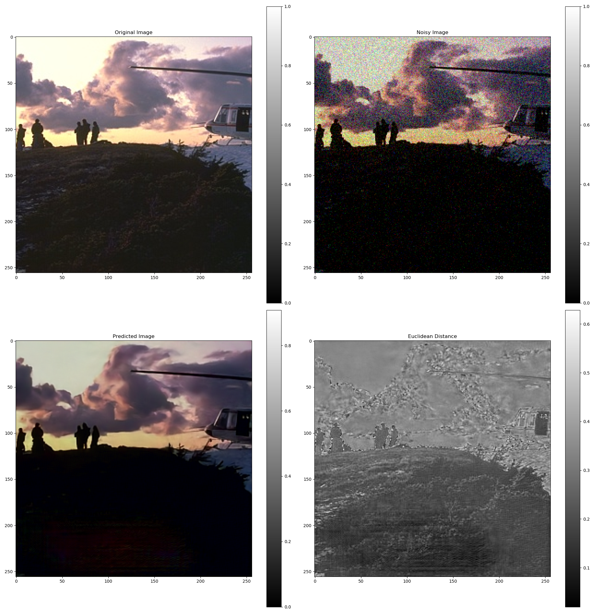
Gaussian Noise

Slide 34

Gaussian Noise
Real World Data
Non-Simulated Noise, Non-Dataset images generated using camera itself while capturing pictures in low exposure
Loss Function: $L2$
Also comparing the prevailing methods

Slide 35
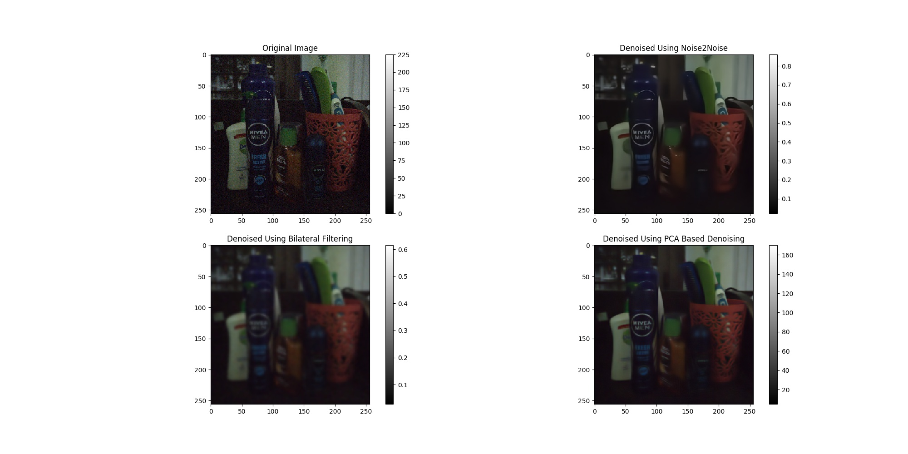
Gaussian Noise

Slide 36
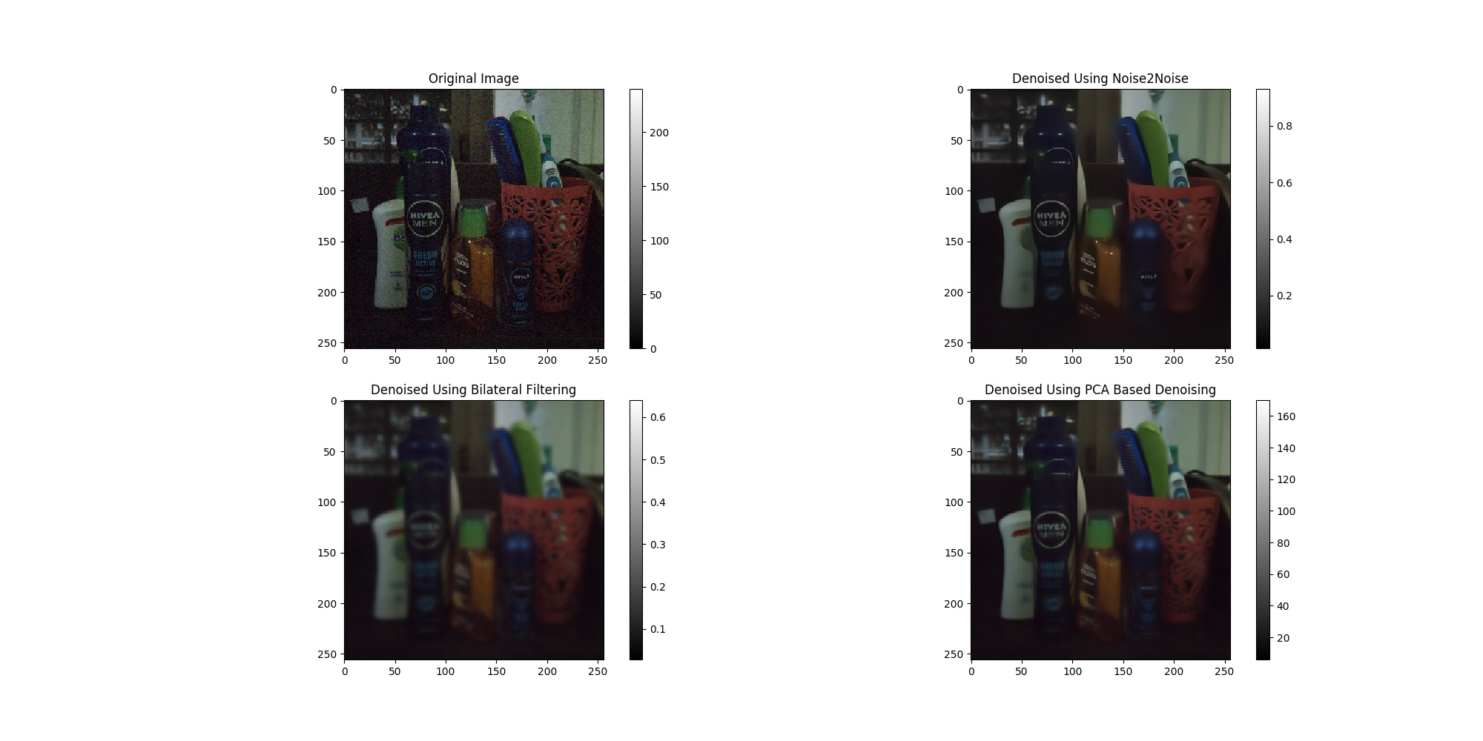
Gaussian Noise

Slide 37
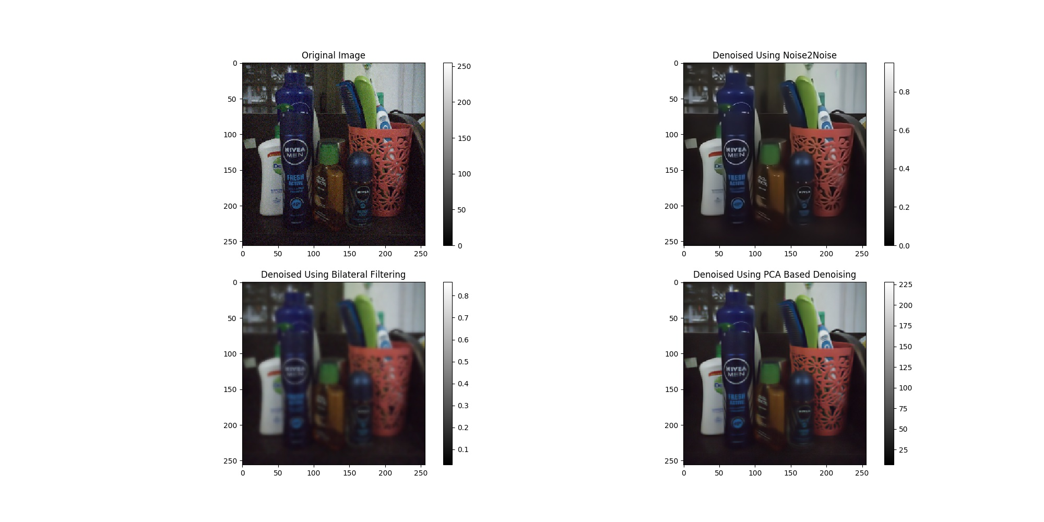
Gaussian Noise

Slide 38

Gaussian Noise
Real World Data
Simulated Noise, Non-Dataset images generated using camera itself while capturing pictures in low exposure
Loss Function: $L2$
Also comparing the prevailing methods

Slide 39
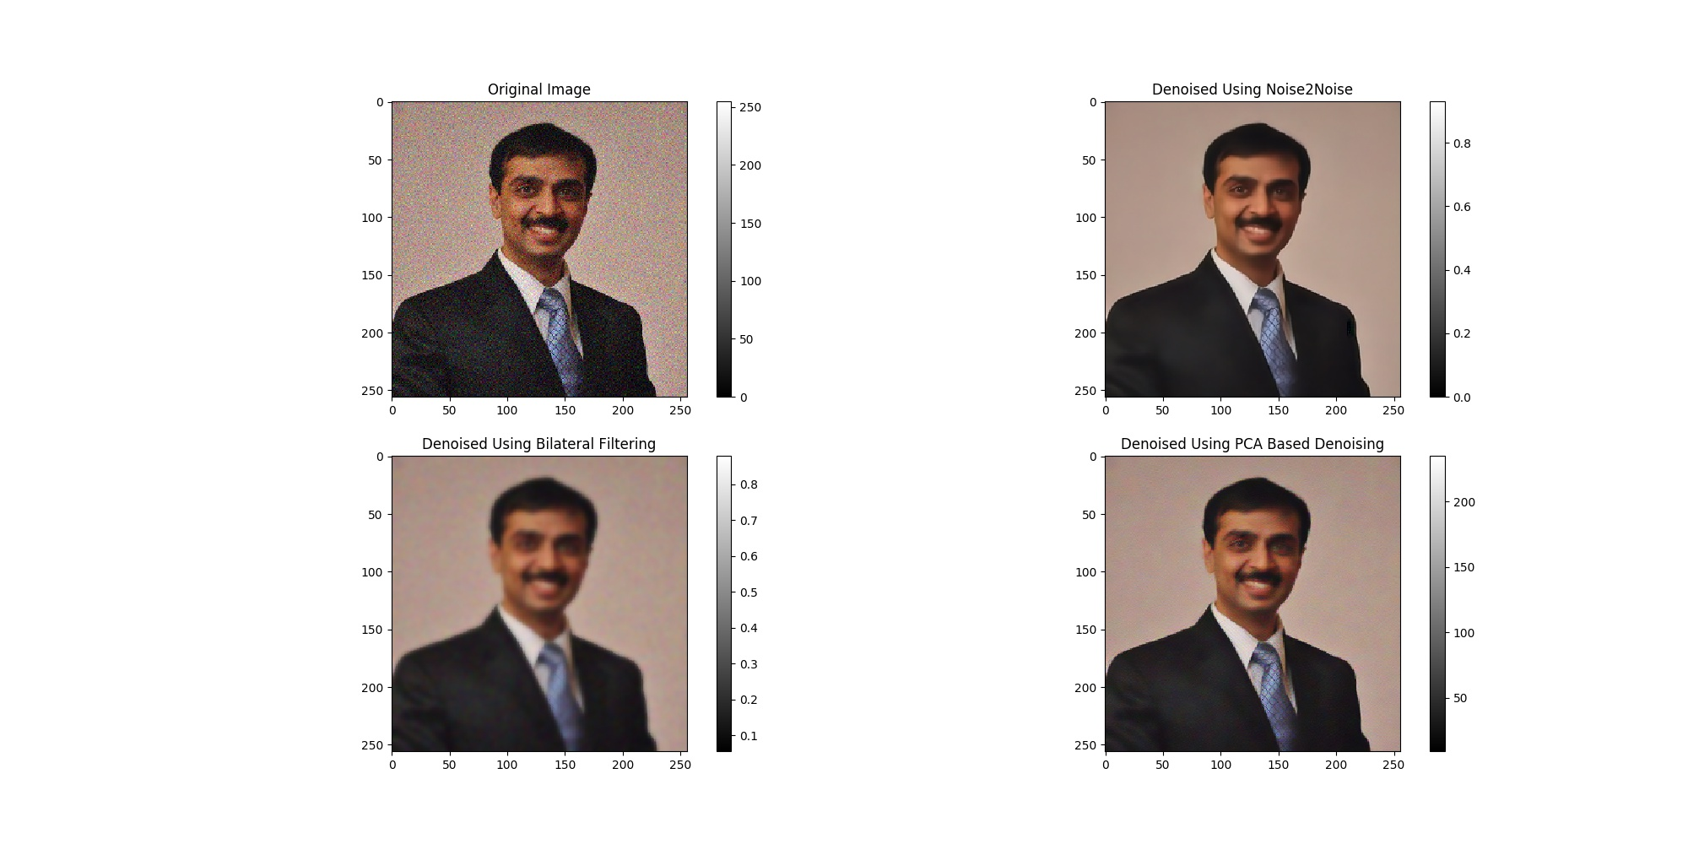
Gaussian Noise

Slide 40
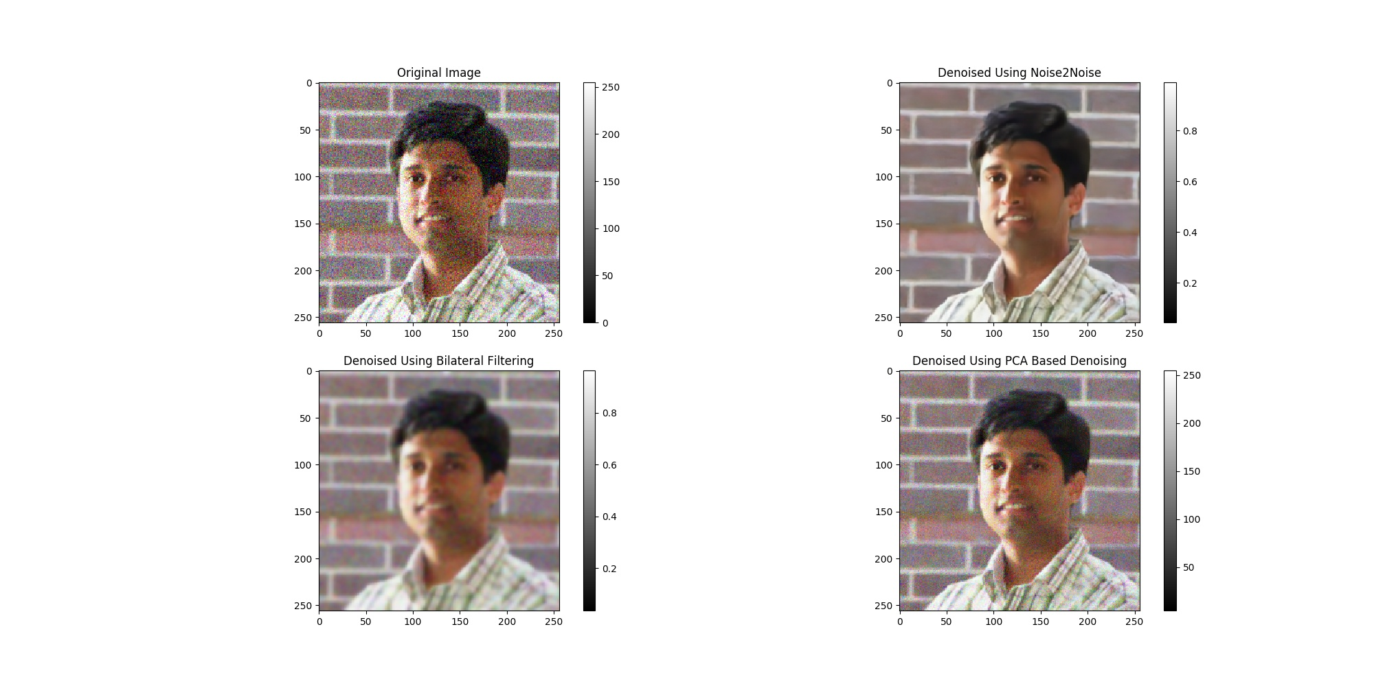
Gaussian Noise

Slide 41
Text Overlay Noise

Slide 42

Text Overlay Noise
Random texts
Random number of strings
Random colours
Random fonts
Loss Function: $L1$

Slide 43
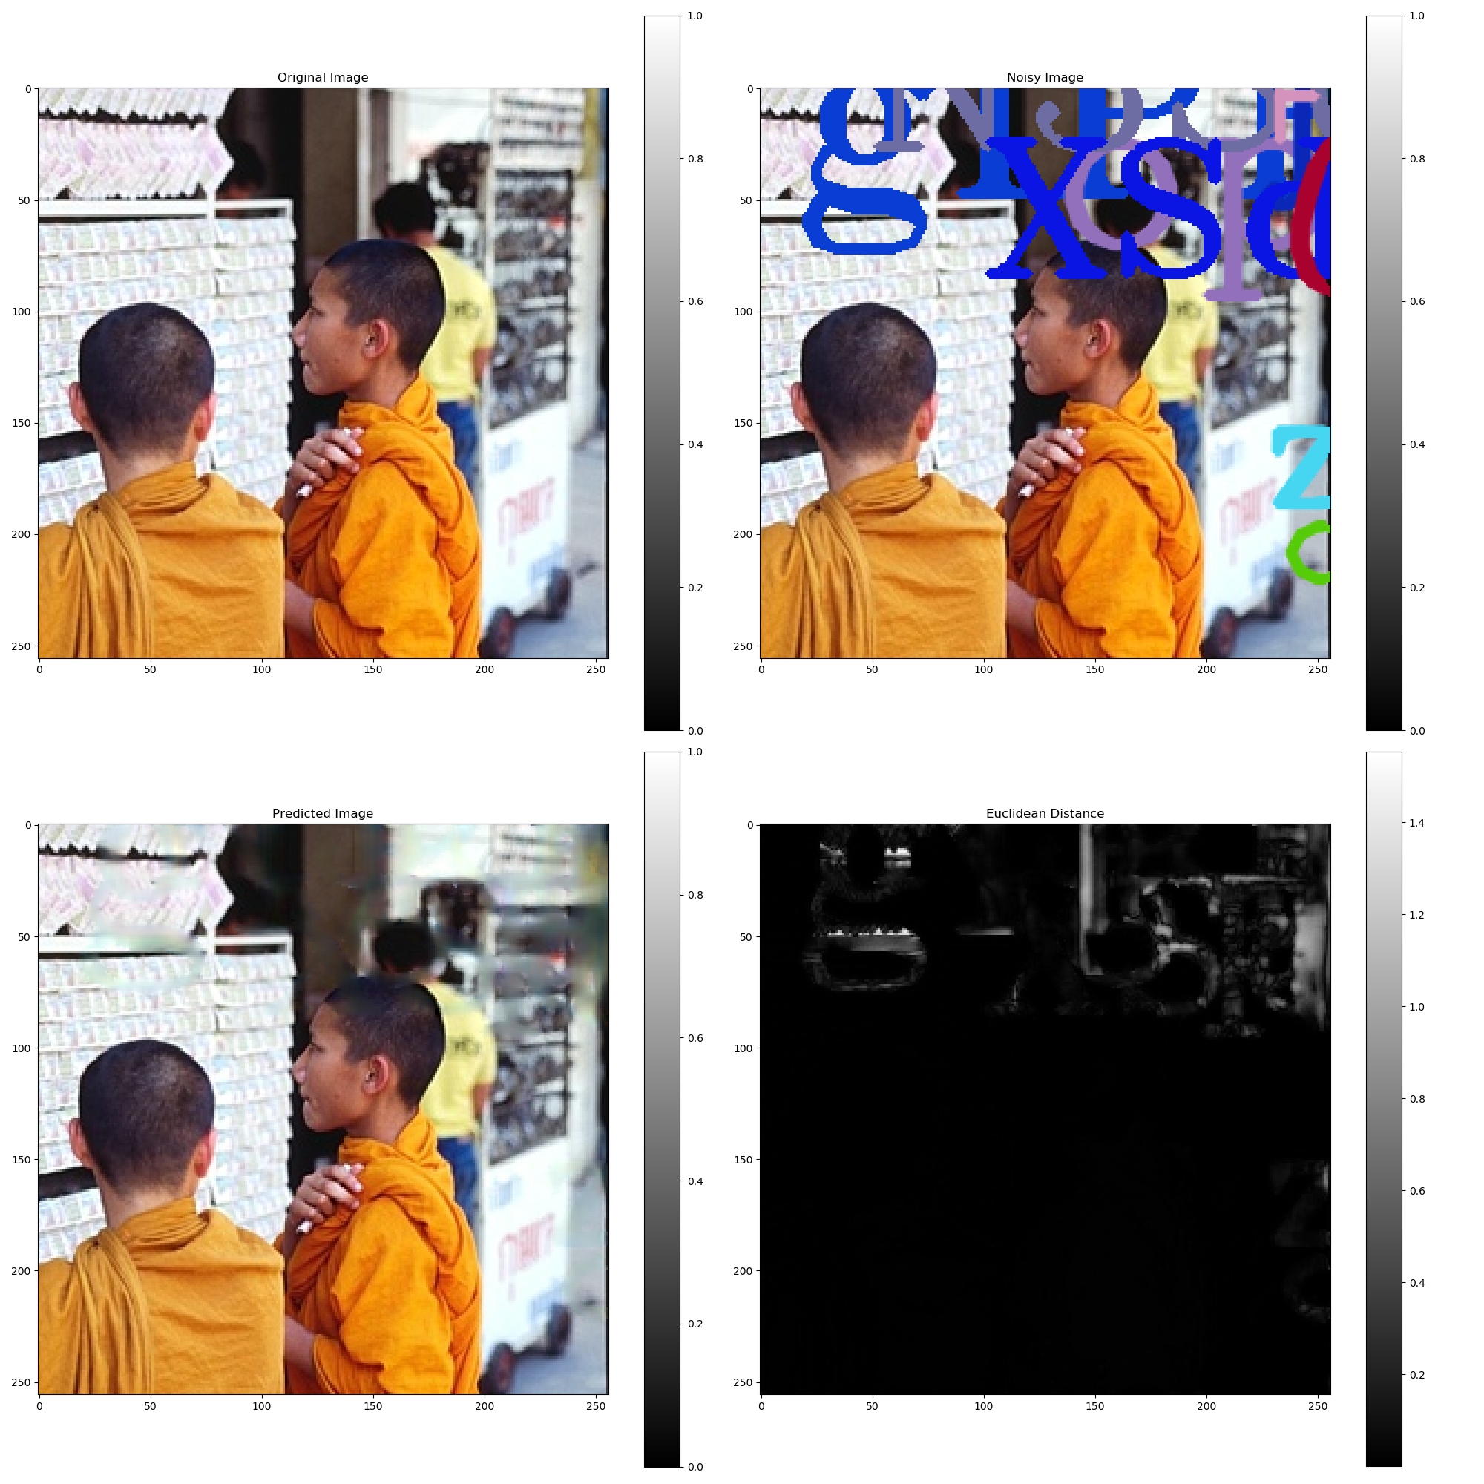
Text Overlay Noise

Slide 44
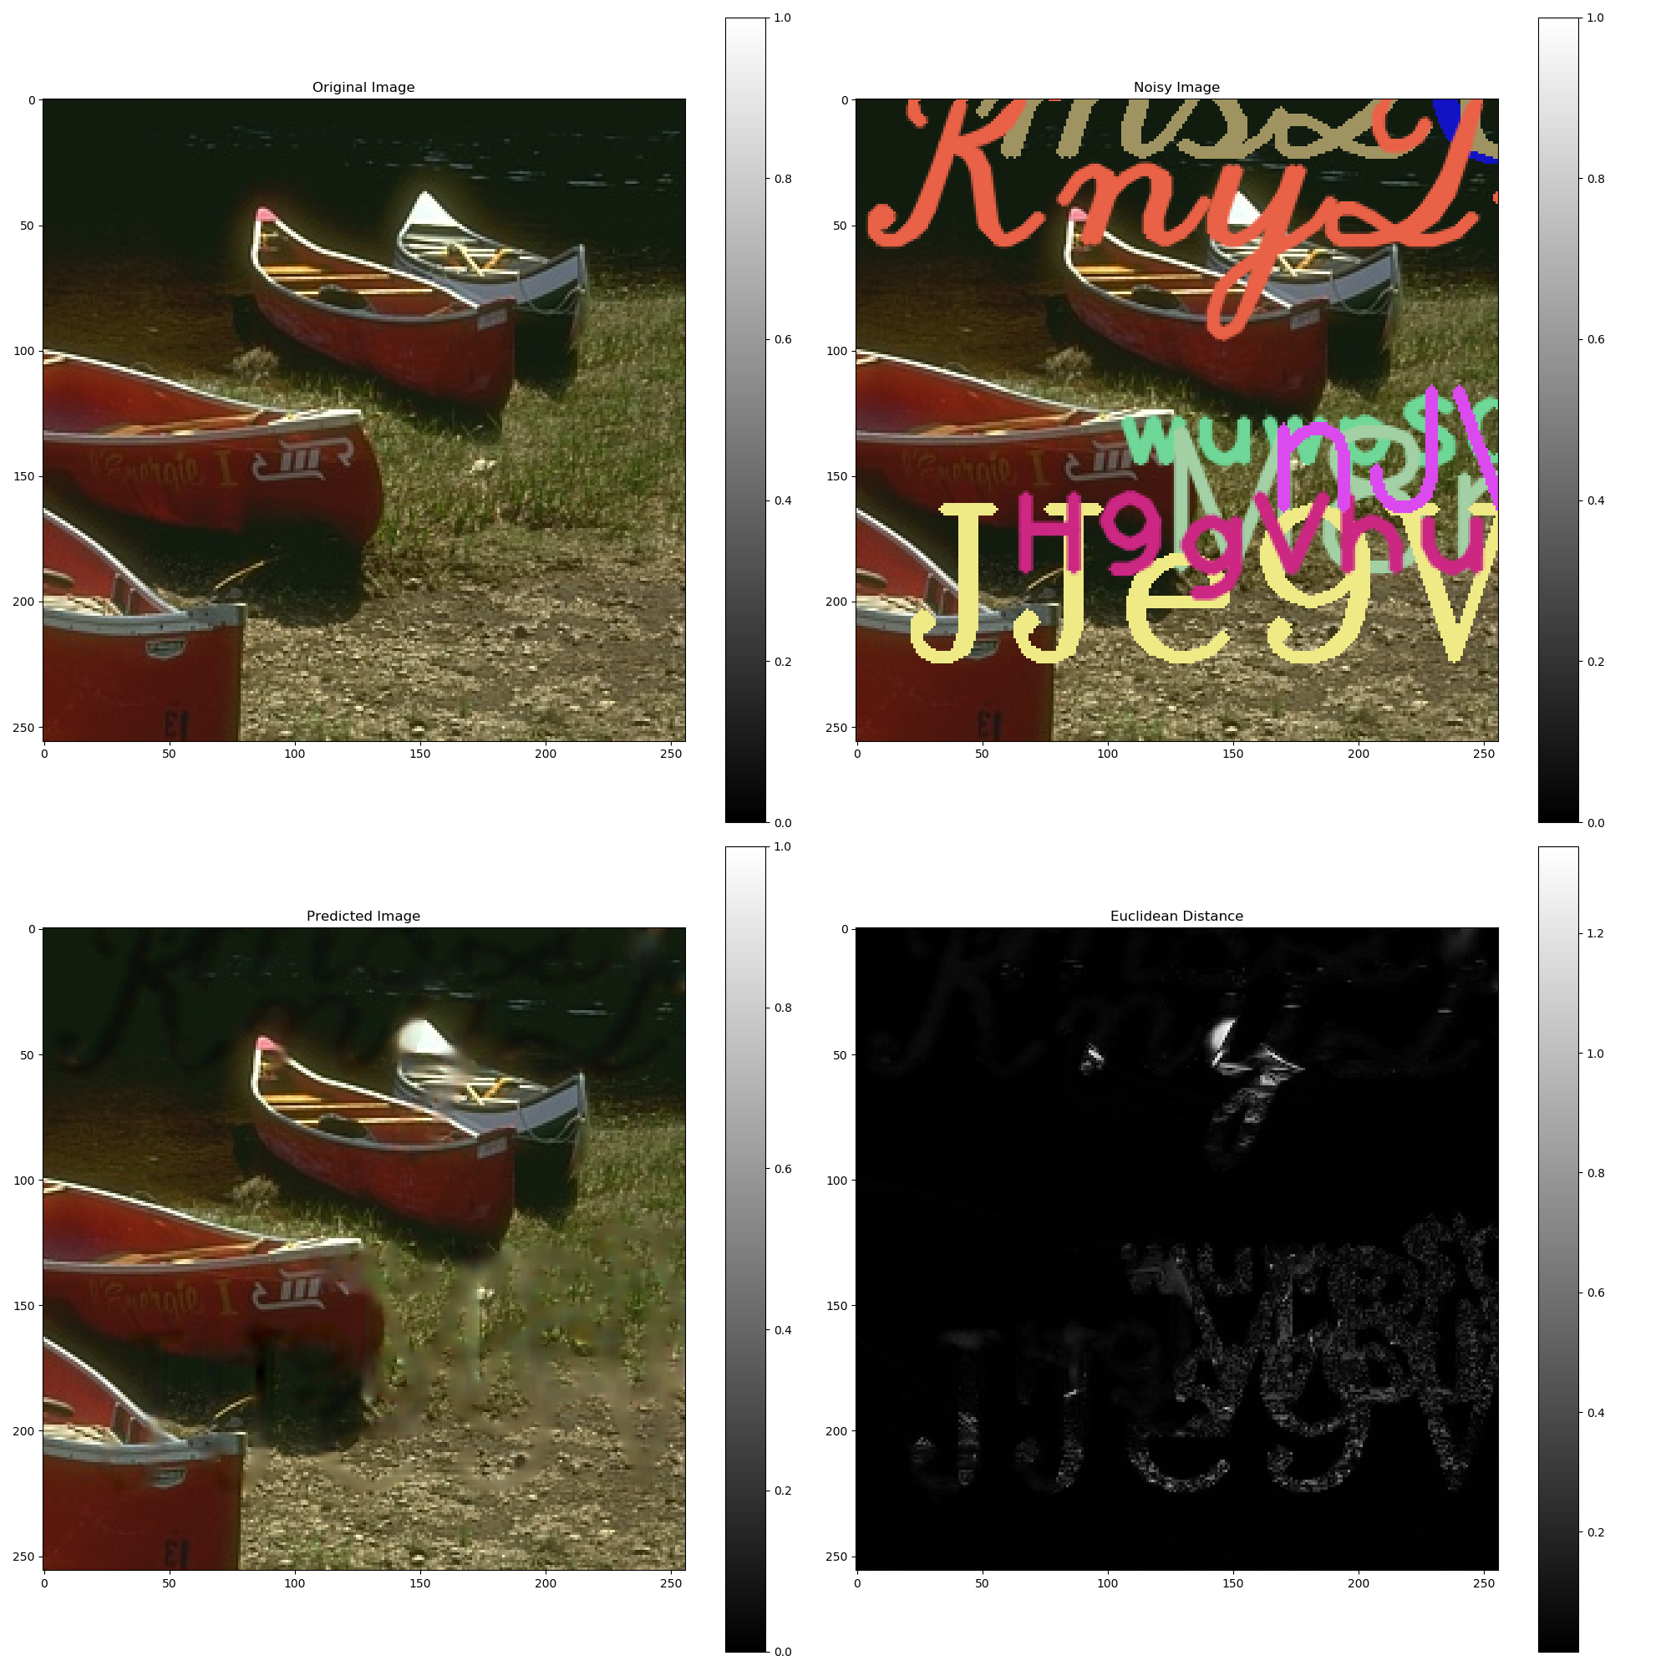
Text Overlay Noise

Slide 45
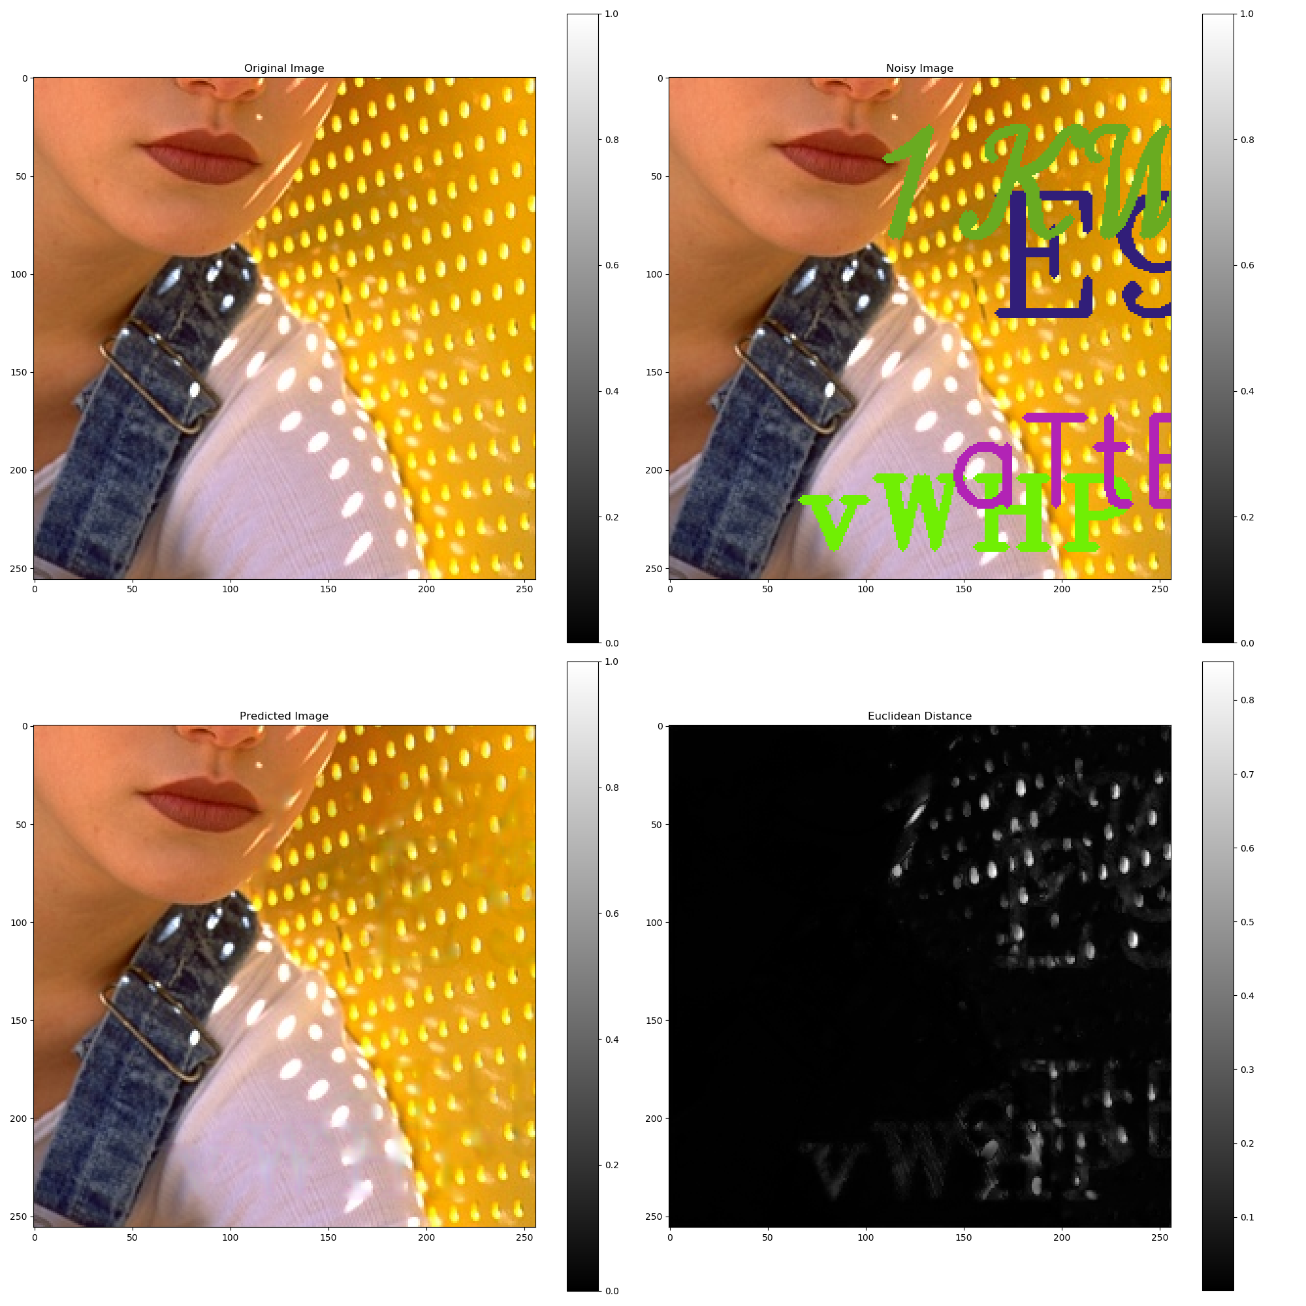
Text Overlay Noise

Slide 46
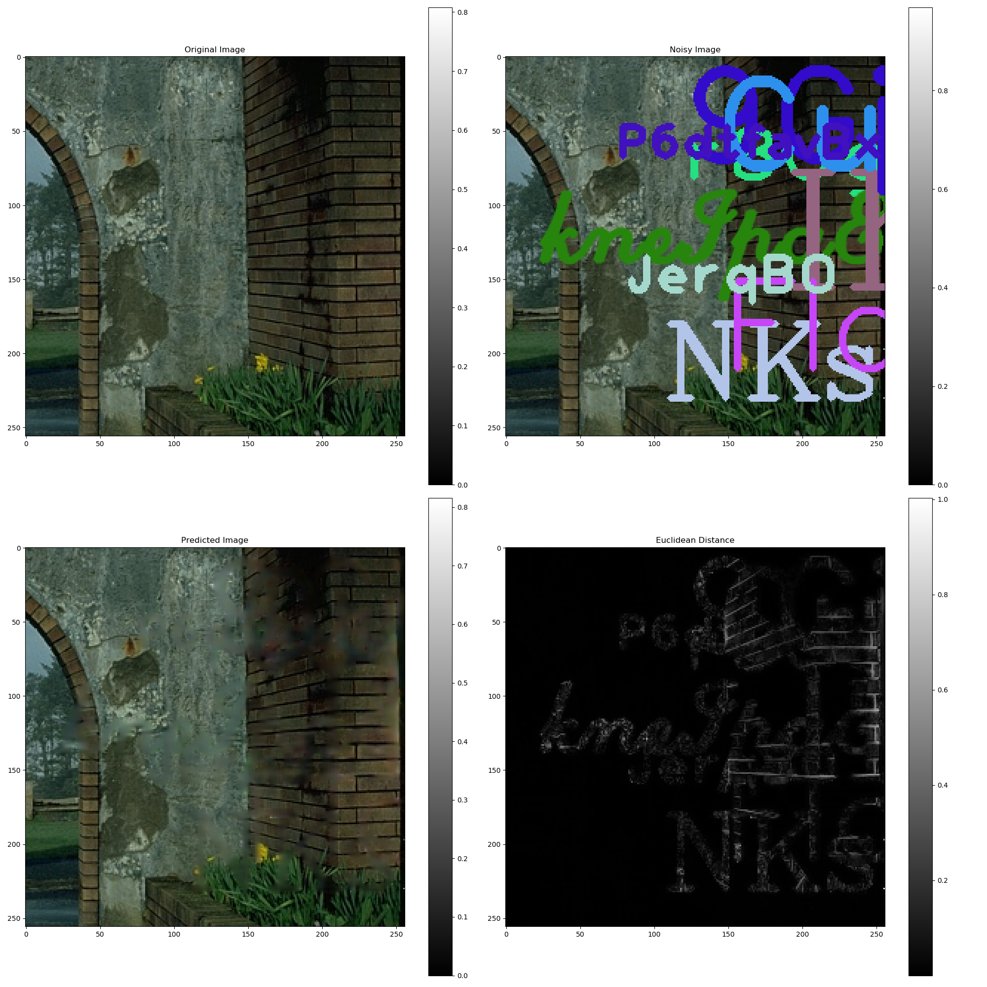
Text Overlay Noise

Slide 47
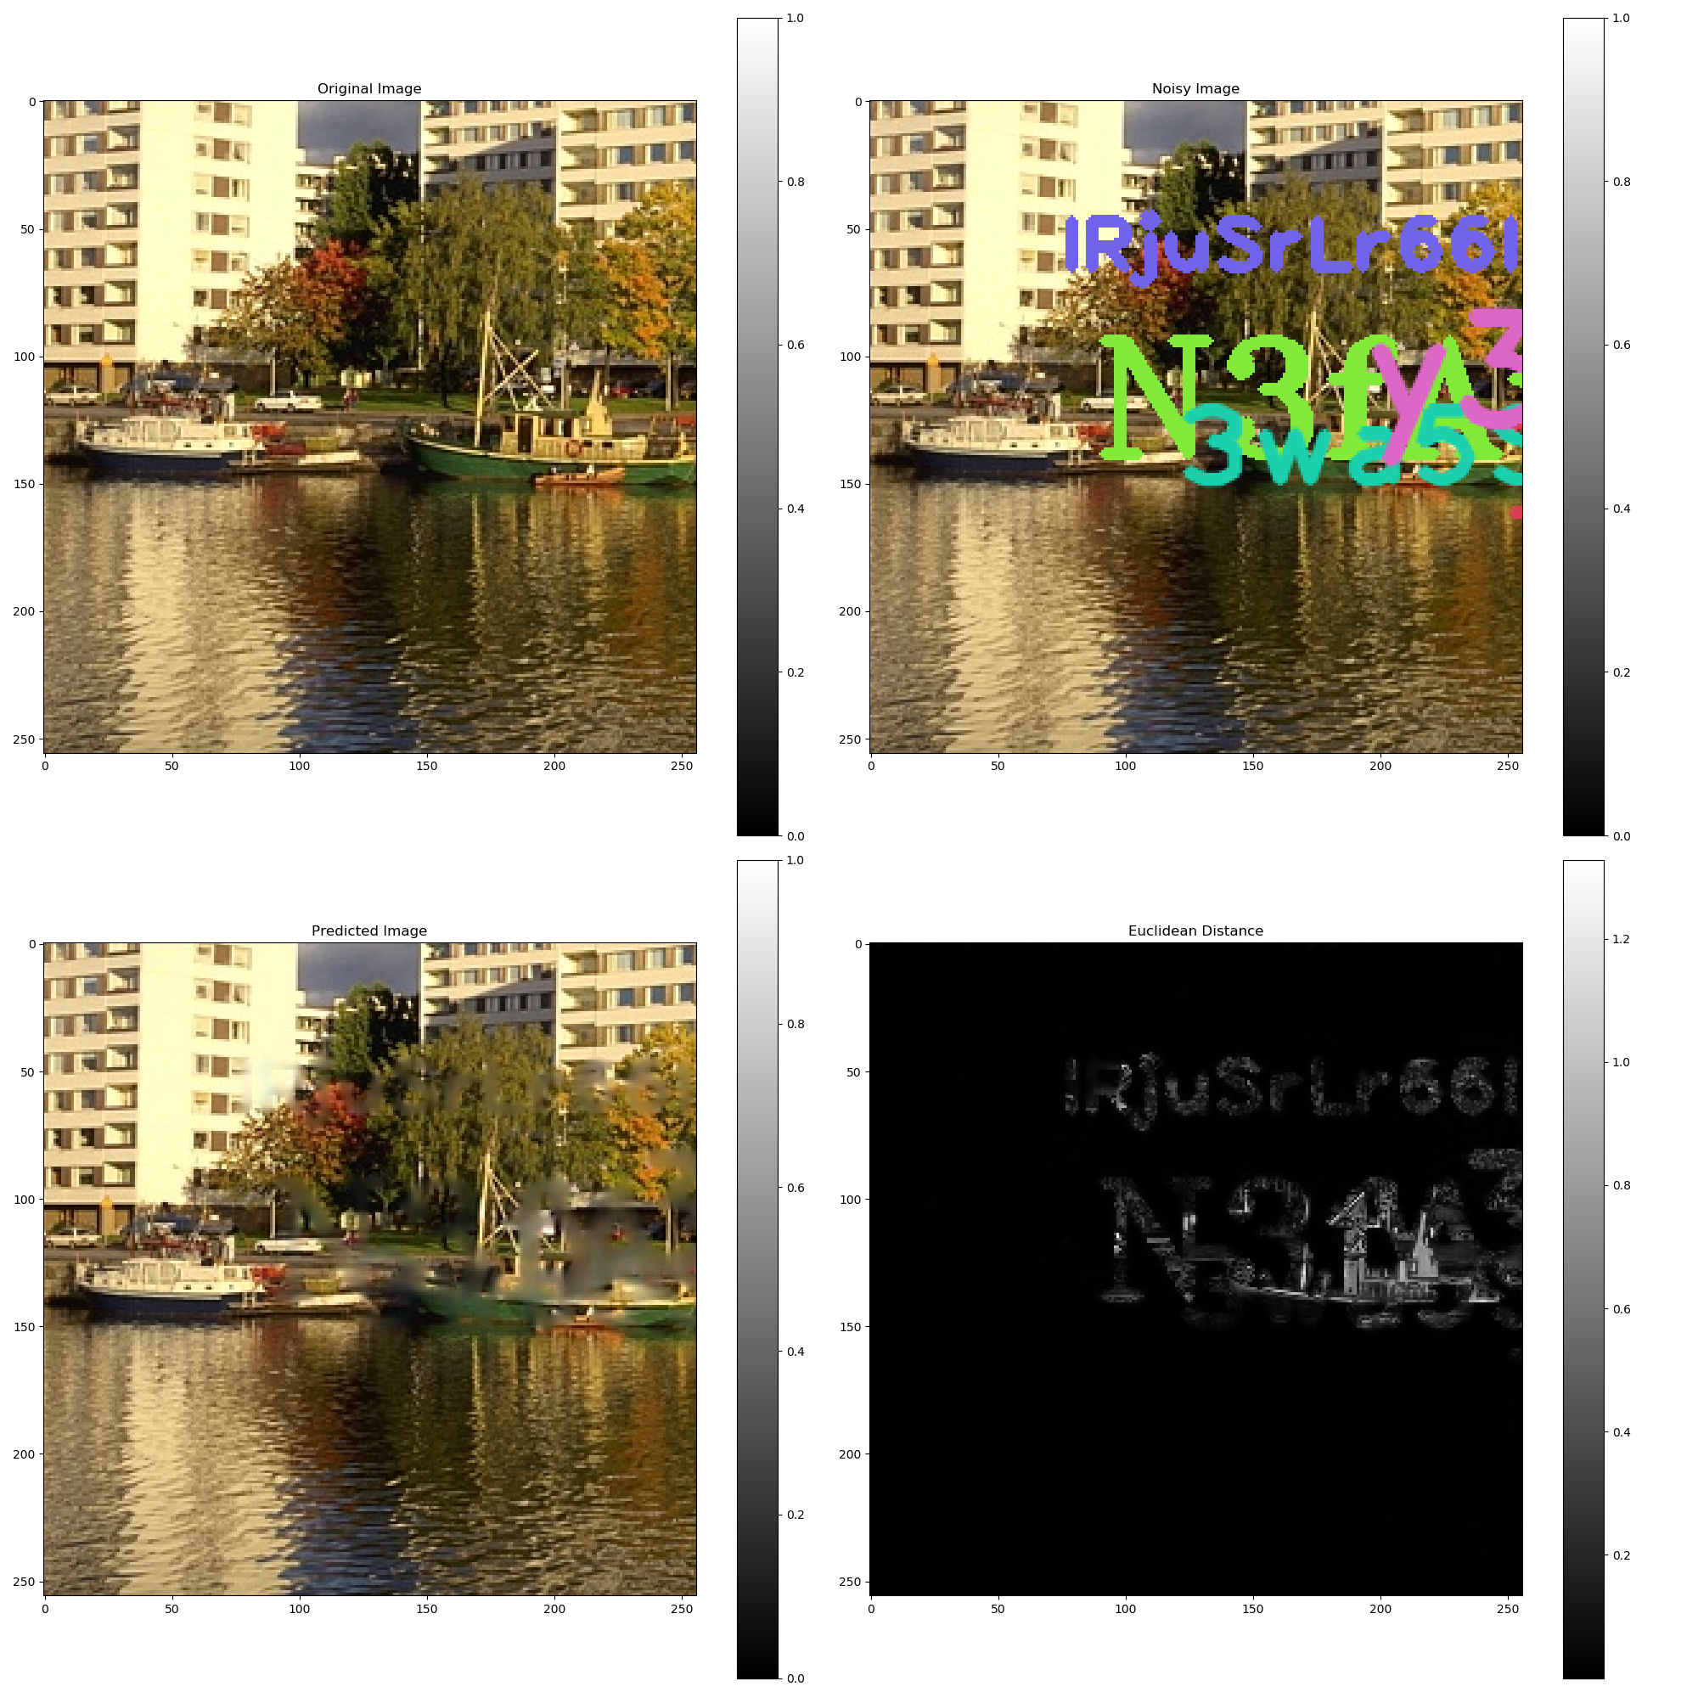
Text Overlay Noise

Slide 48
Putting it to TEST!

Slide 49
Salt and Pepper Noise

Slide 50

Salt and Pepper Noise
$Pr⁡(Pixel = BLACK) = 0.05$
$Pr⁡(Pixel = WHITE) = 0.05$
$Pr⁡(Pixel = ORIGINAL) = 0.9$
Loss Function: $L1$

Slide 51
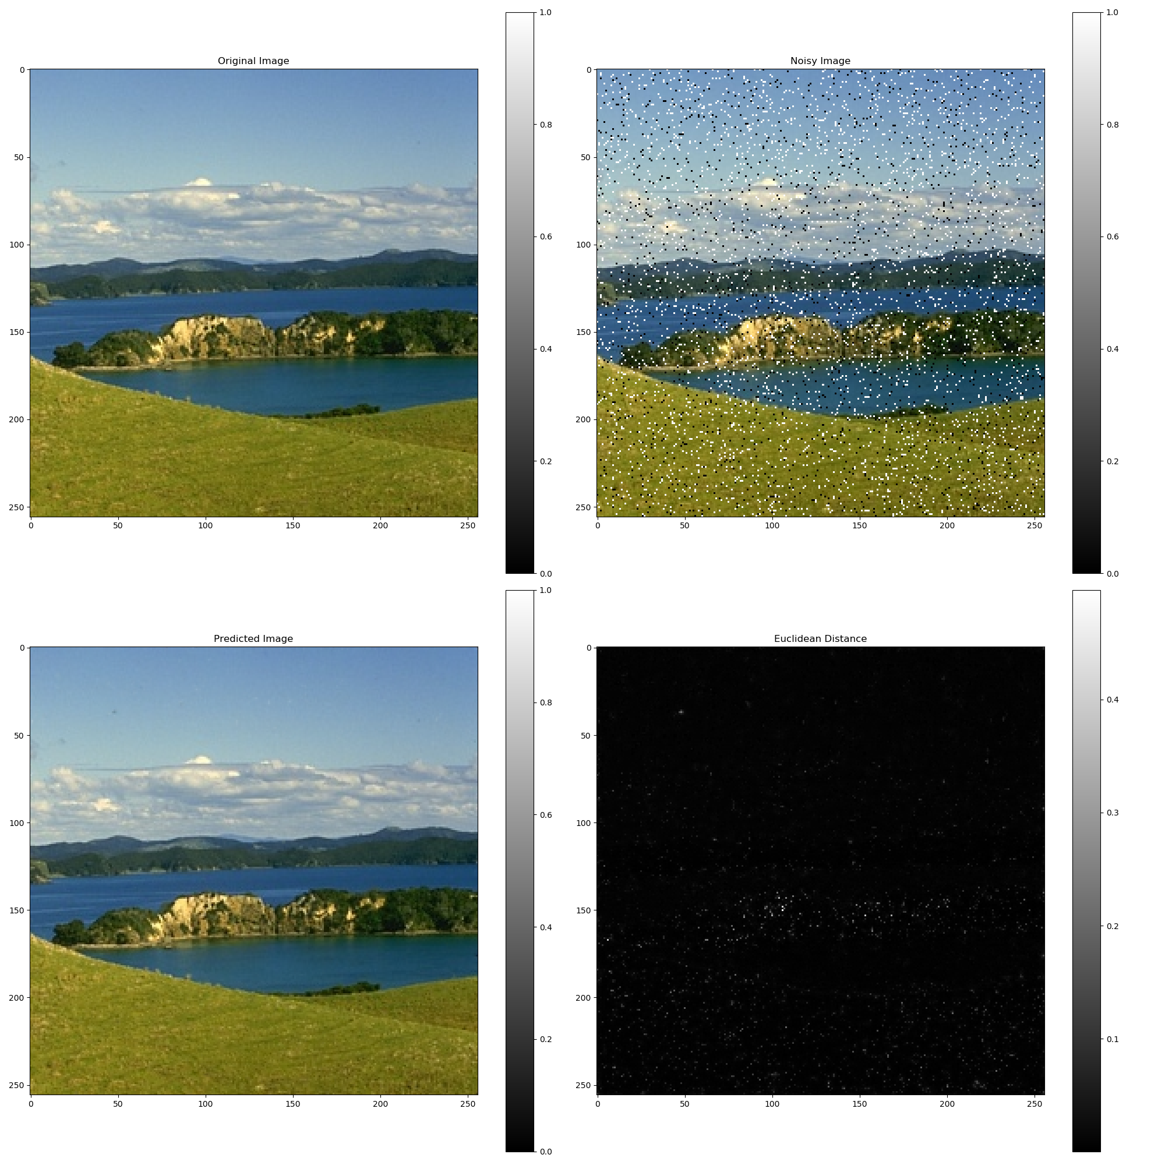
Salt and Pepper Noise

Slide 52
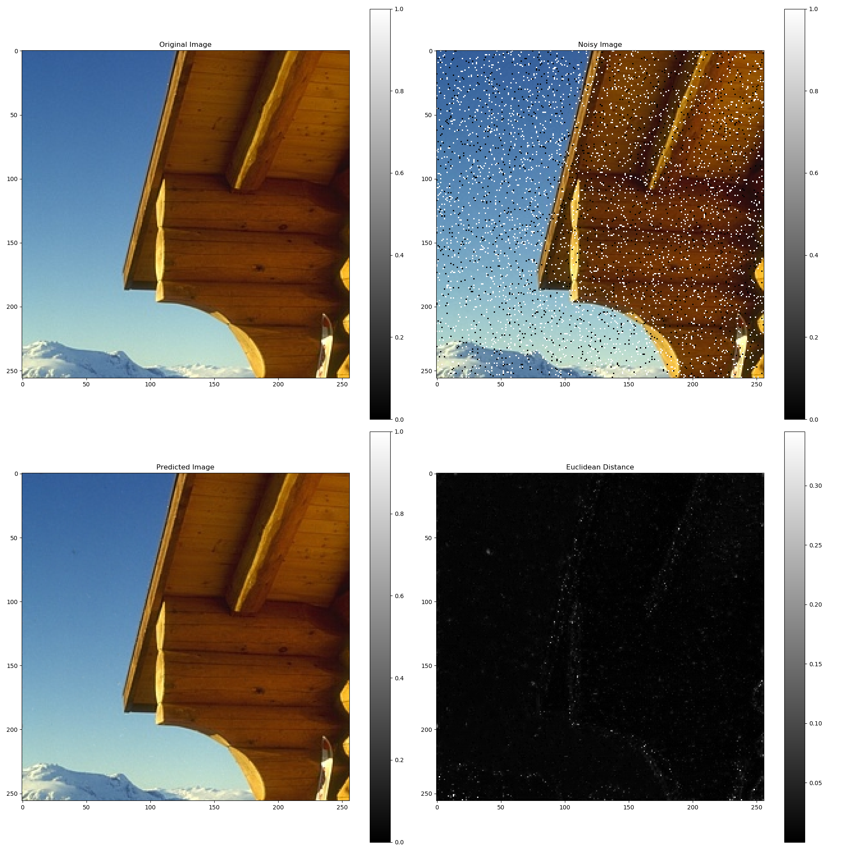
Salt and Pepper Noise

Slide 53
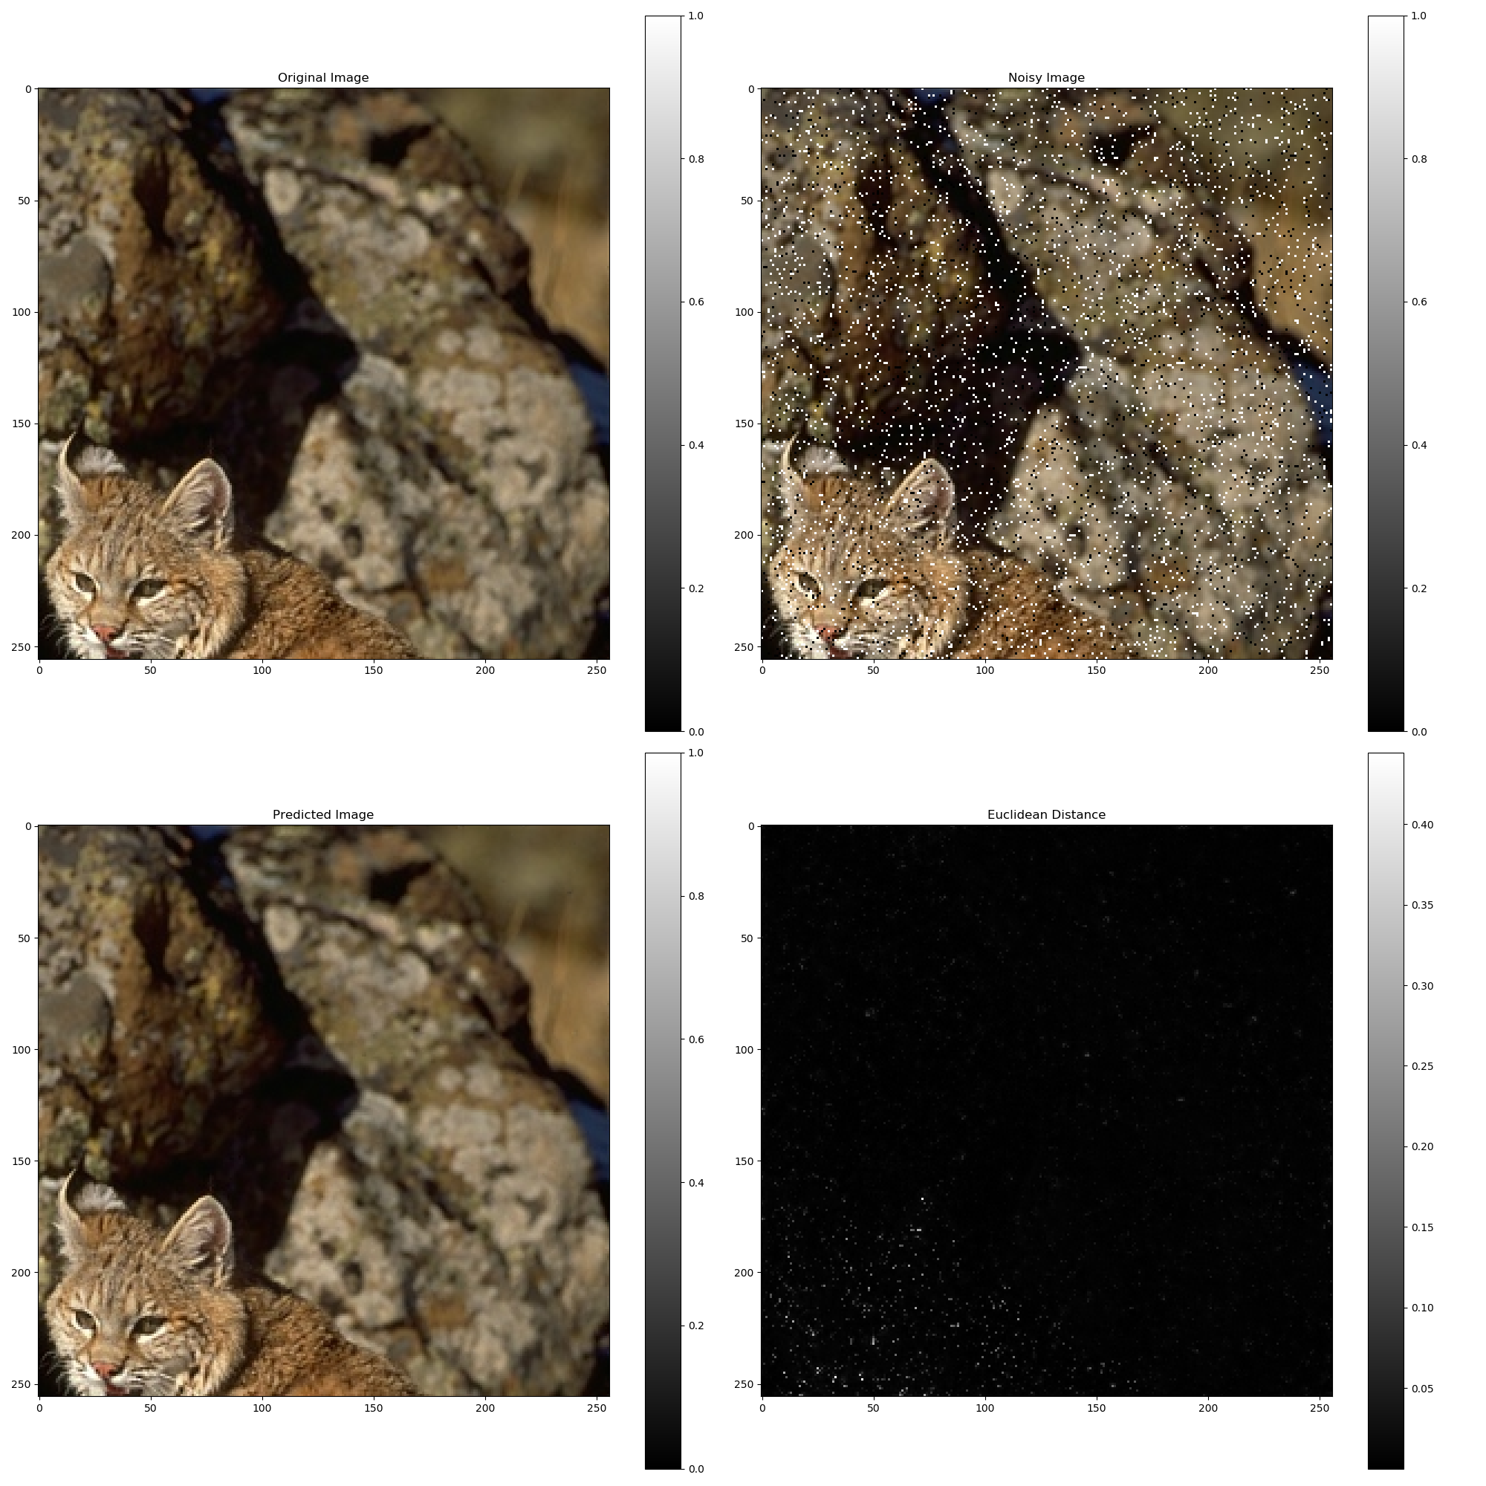
Salt and Pepper Noise

Slide 54

Salt and Pepper Noise
Verifying that Salt and Pepper shouldn’t converge using $L2$ but only $L1$.

Slide 55
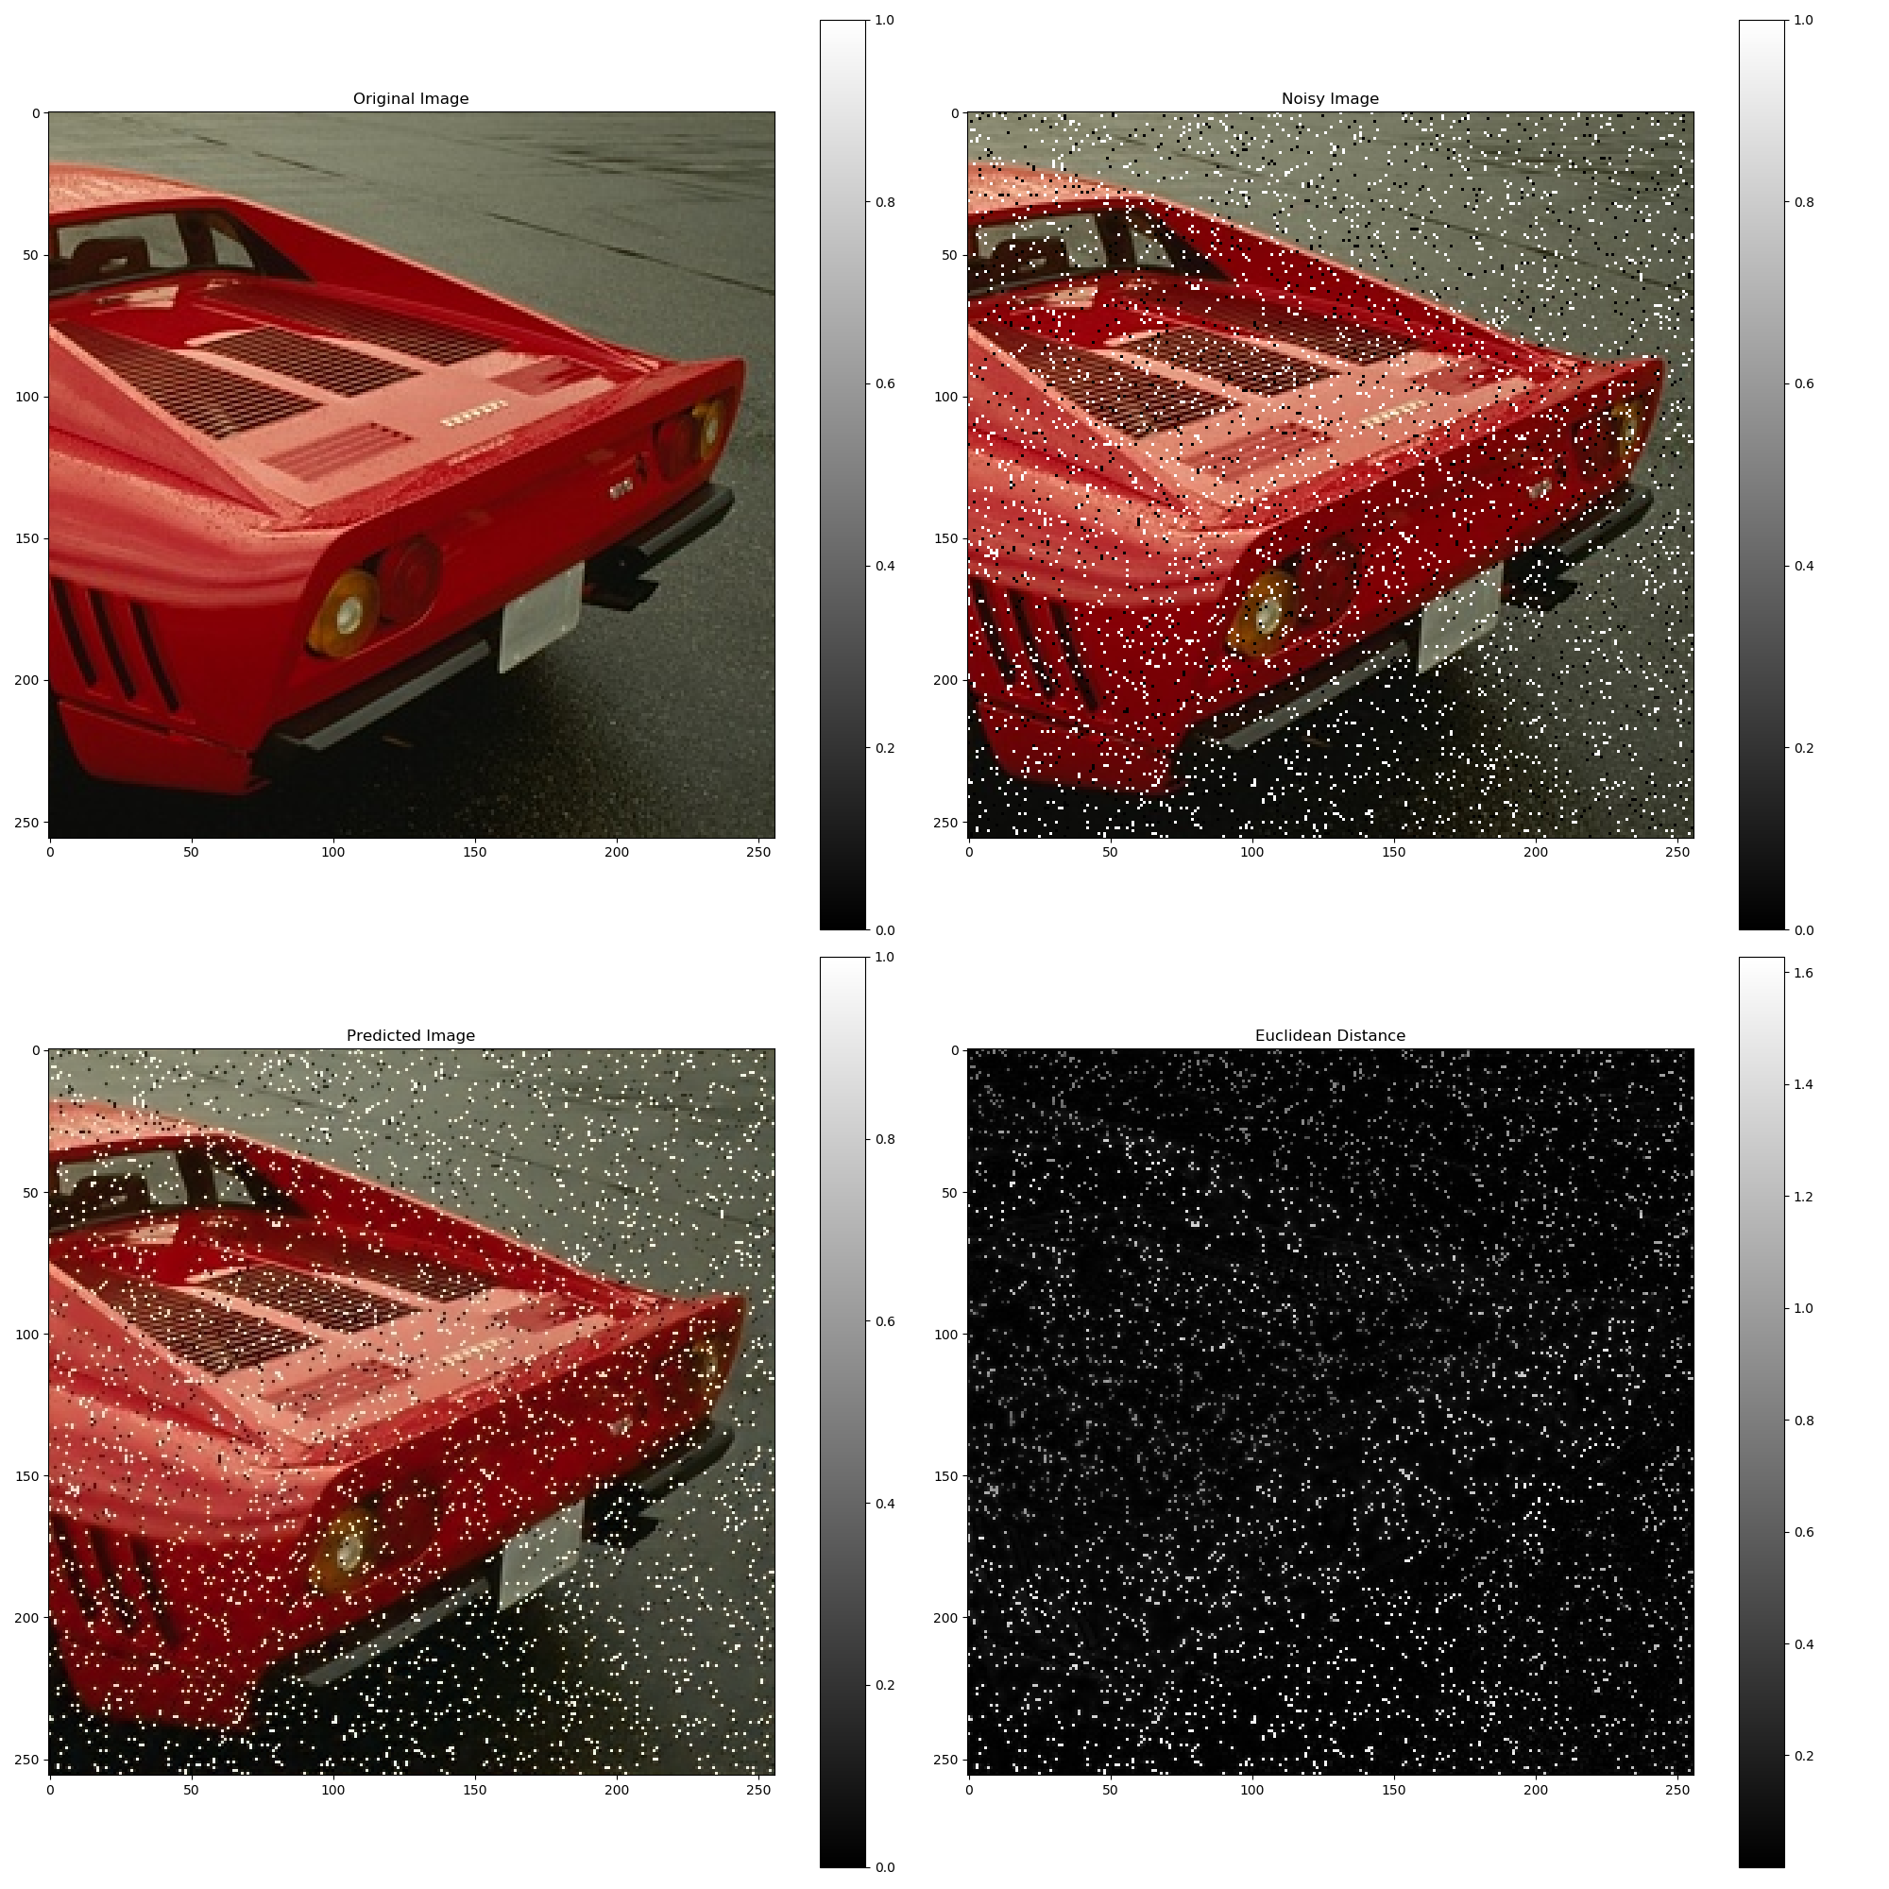
Salt and Pepper Noise

Slide 56
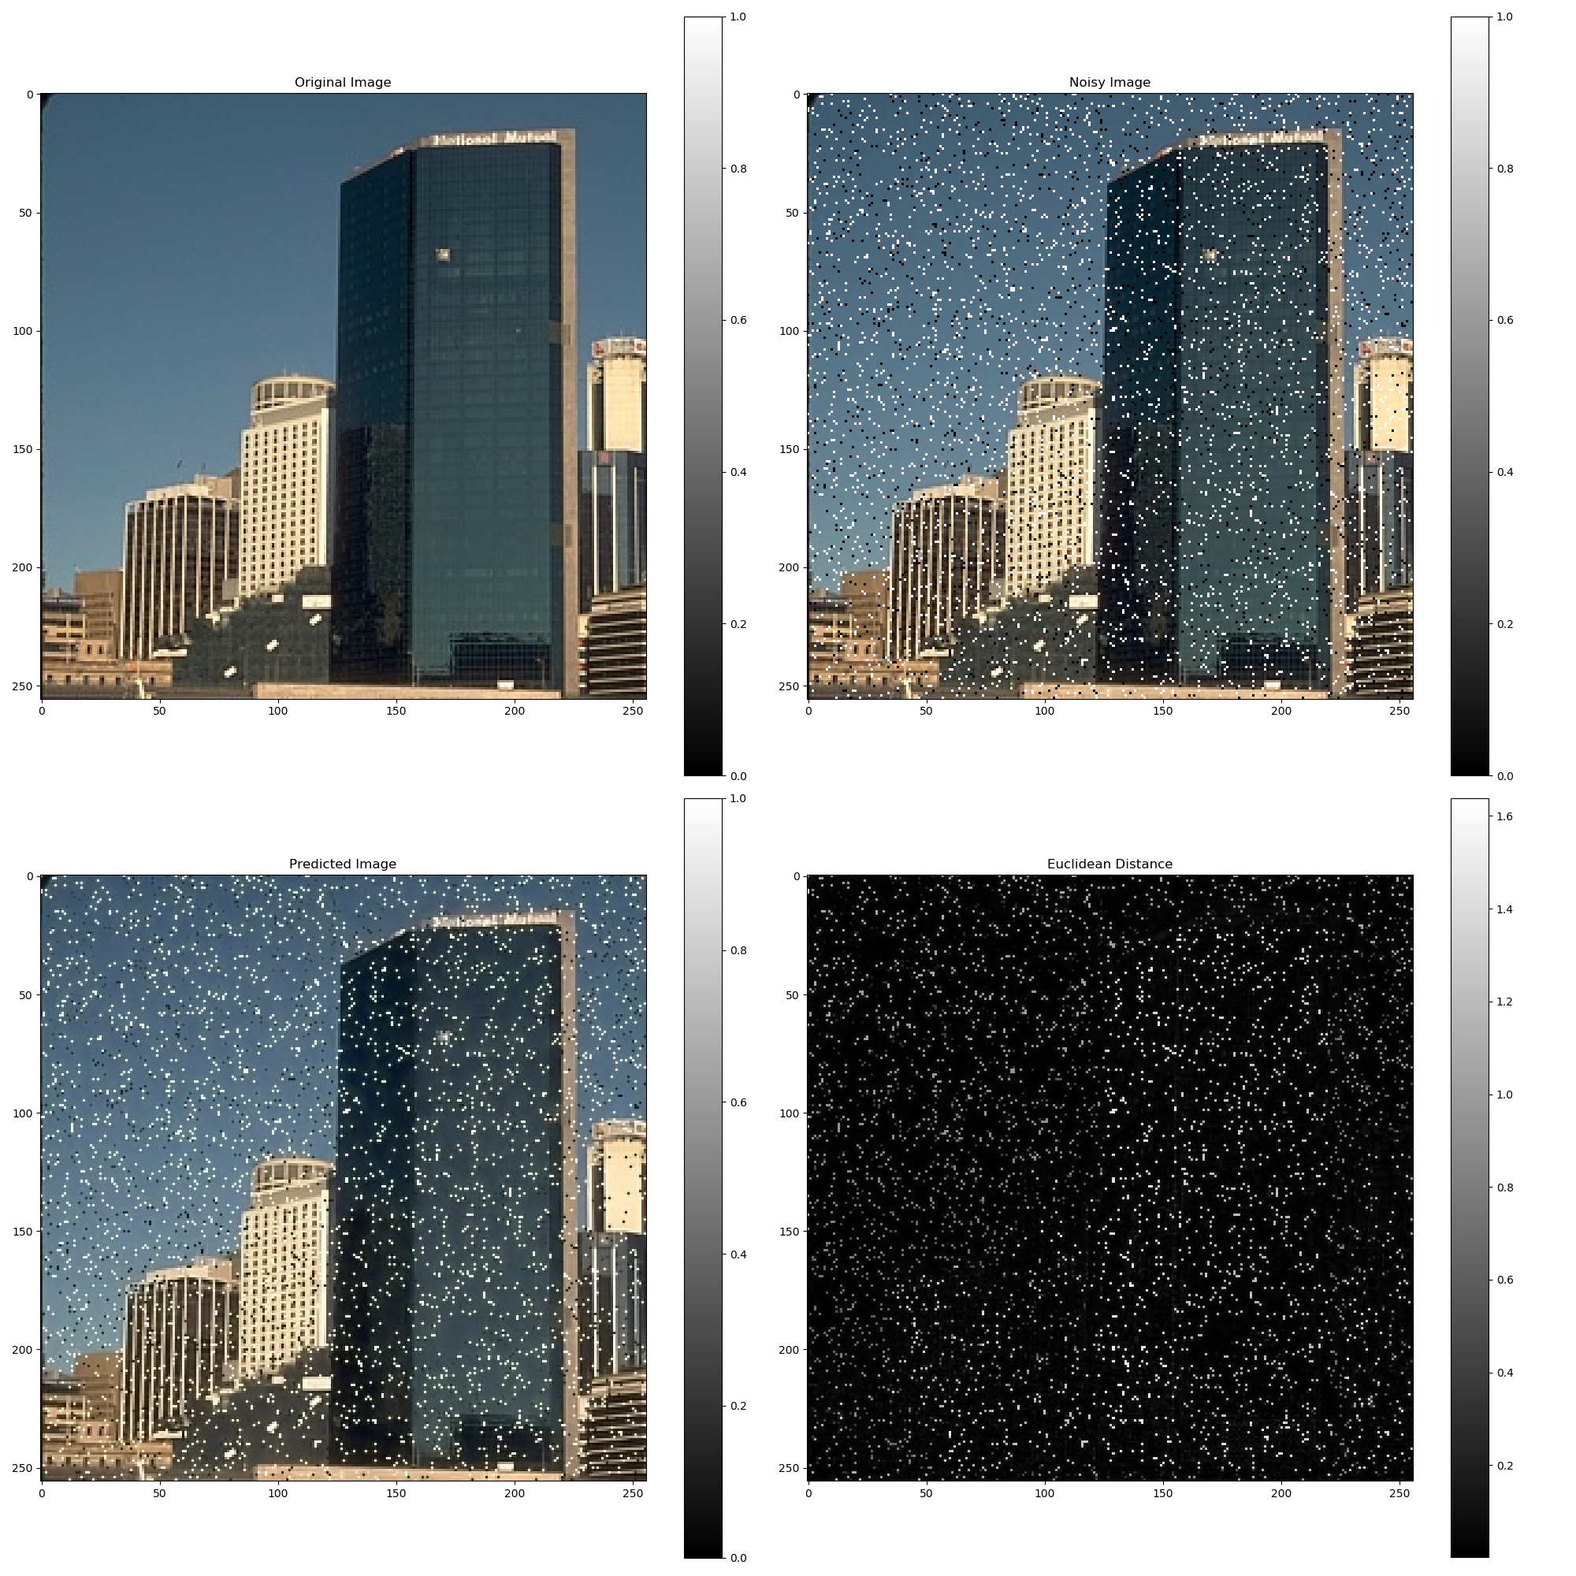
Salt and Pepper Noise

Slide 57
Is UNET Important?

Slide 58
Is UNET Important?
Seems like, from the experiments we ran

Slide 59
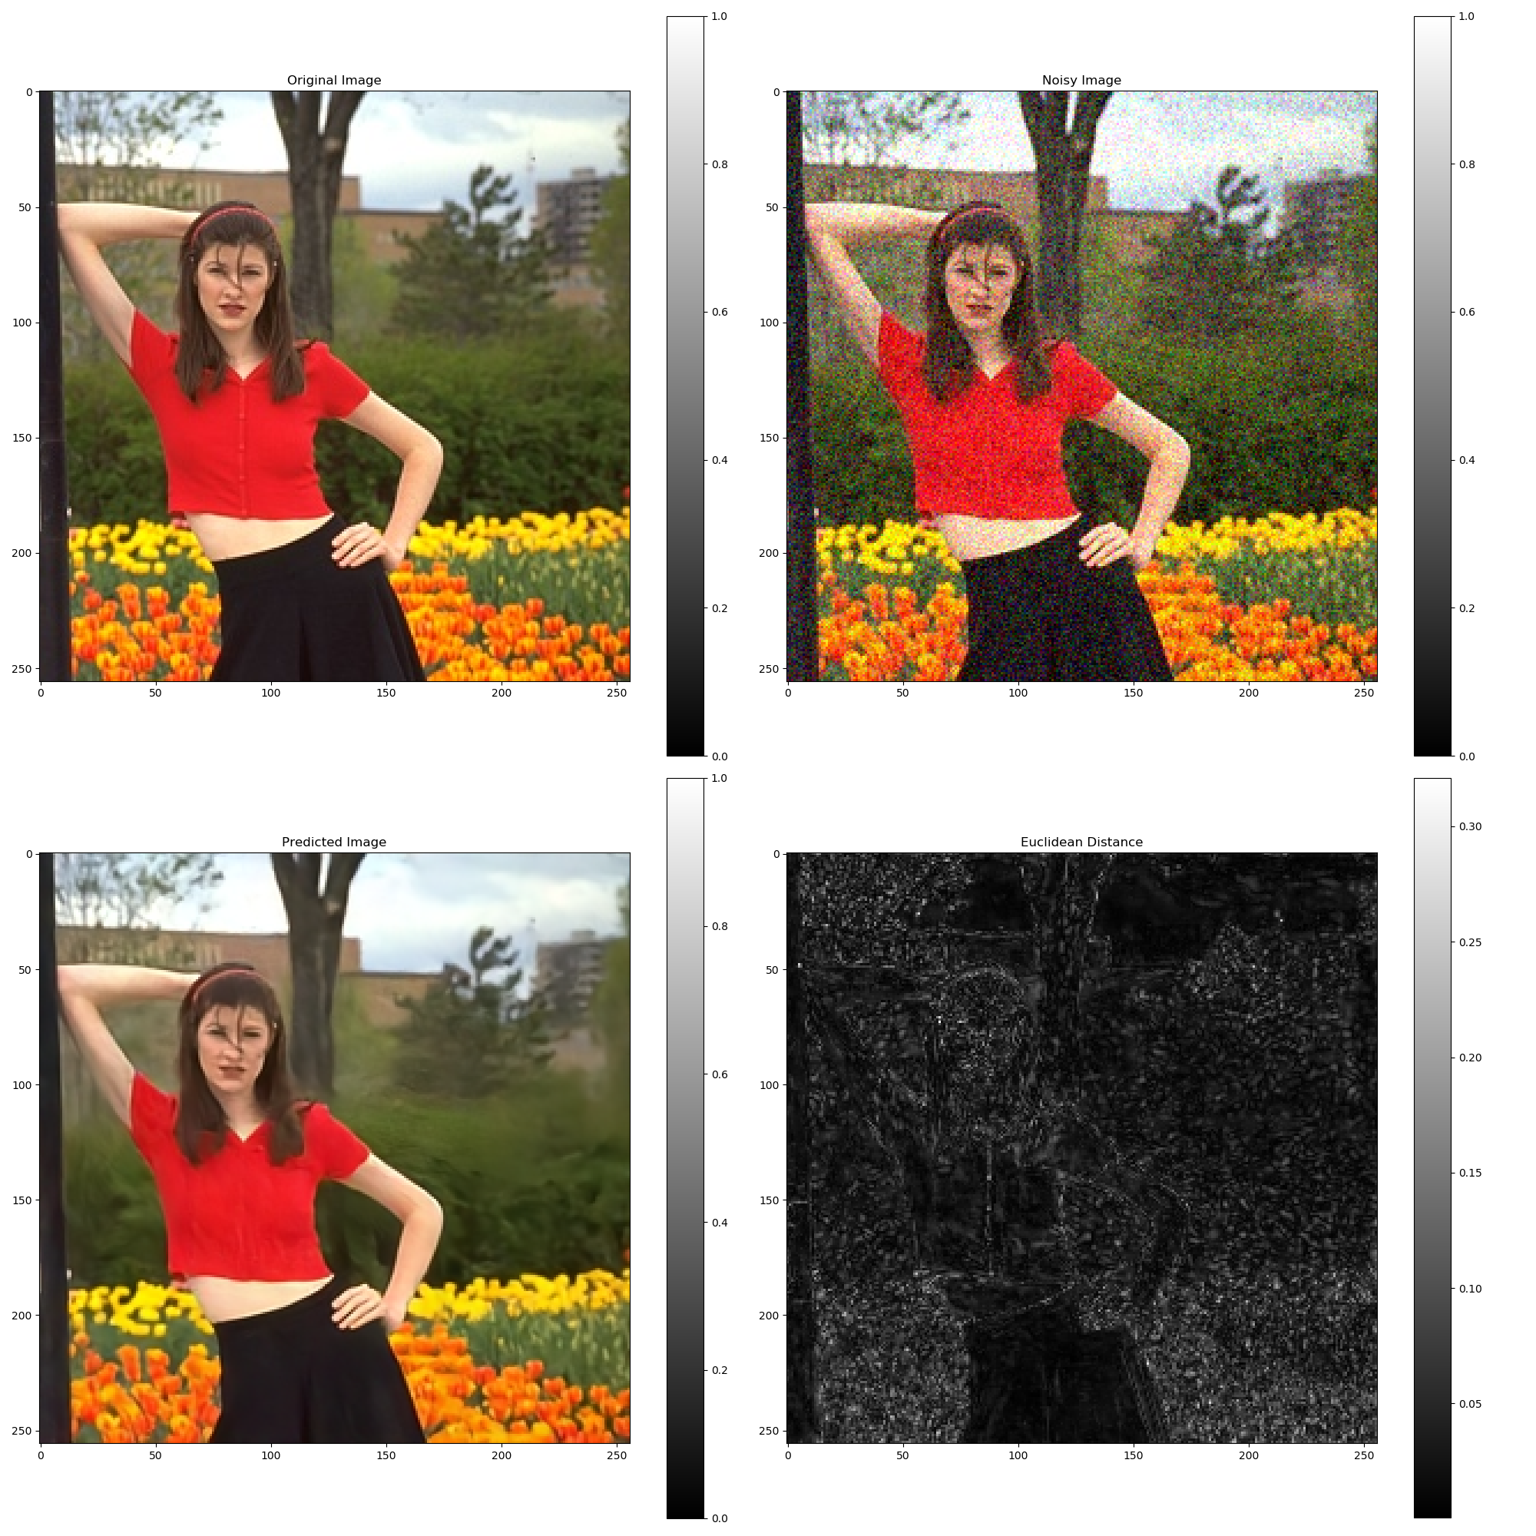
UNET Performance after 1 epoch

Slide 60
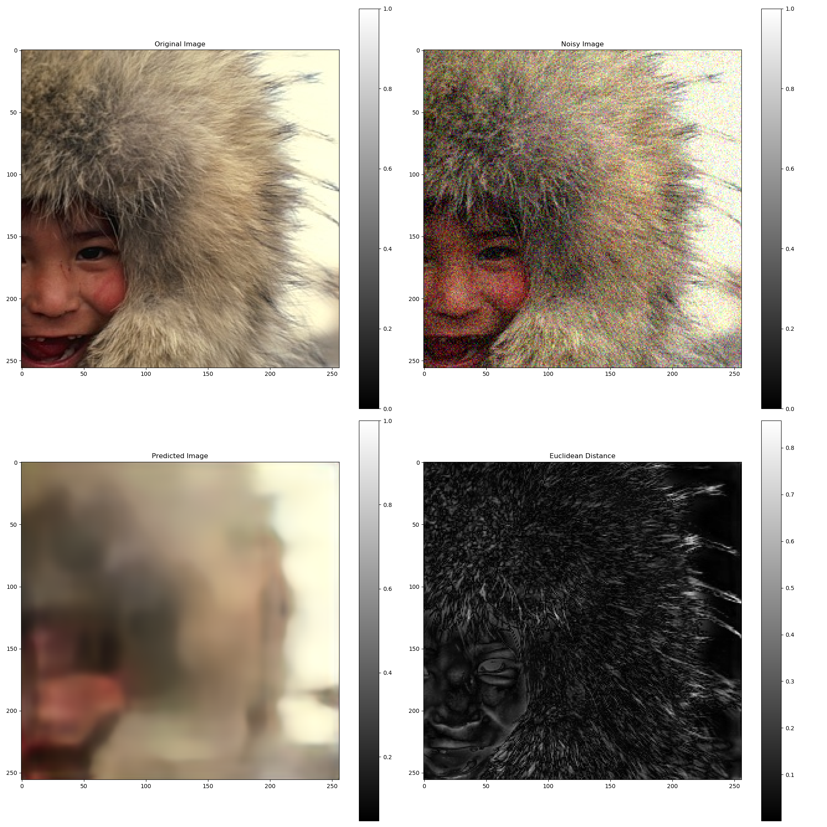
ED Performance after 1 epoch

Slide 61
Thank You

